Slide 1


Slide 2


Slide 3
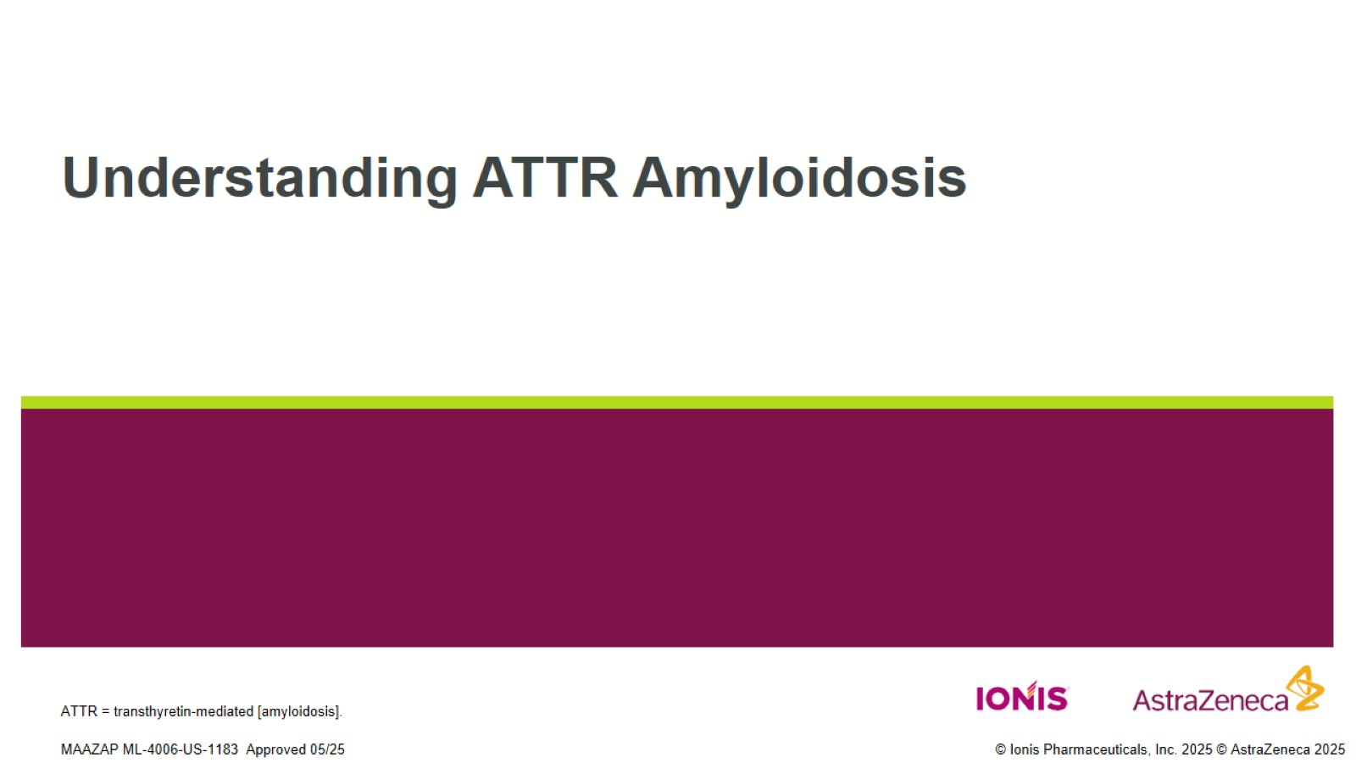
Understanding ATTR Amyloidosis

Slide 4
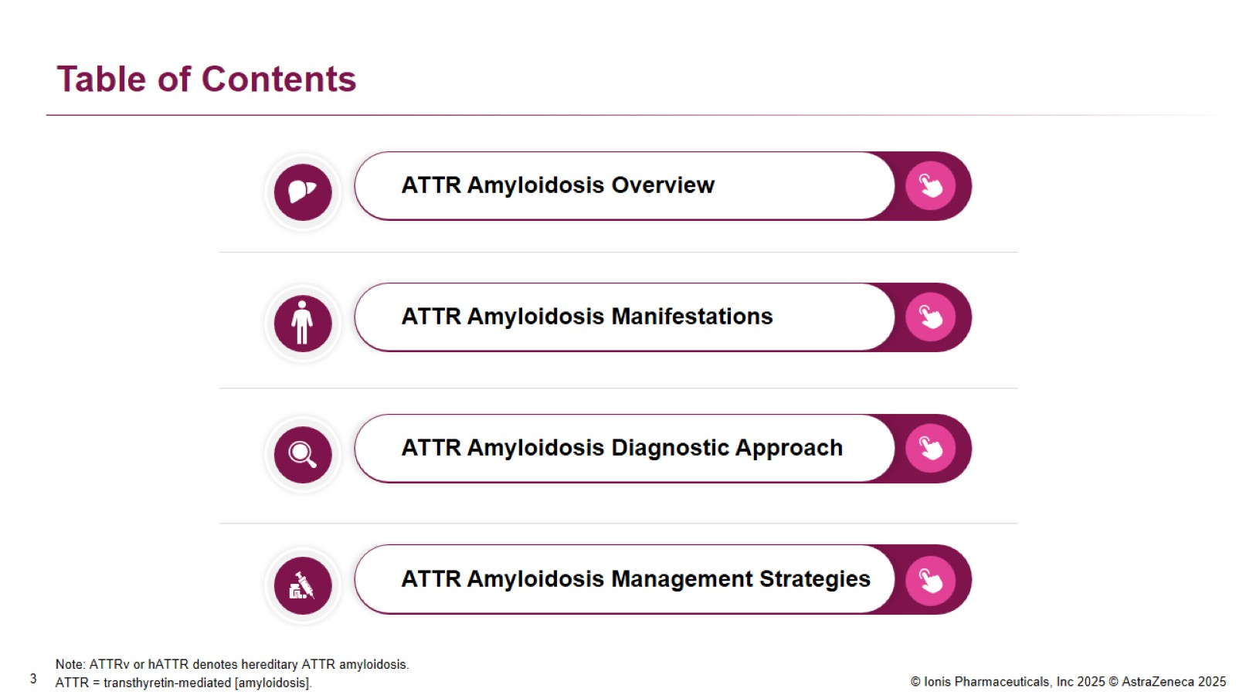
Table of Contents

Slide 5

ATTR Amyloidosis Overview

Slide 6
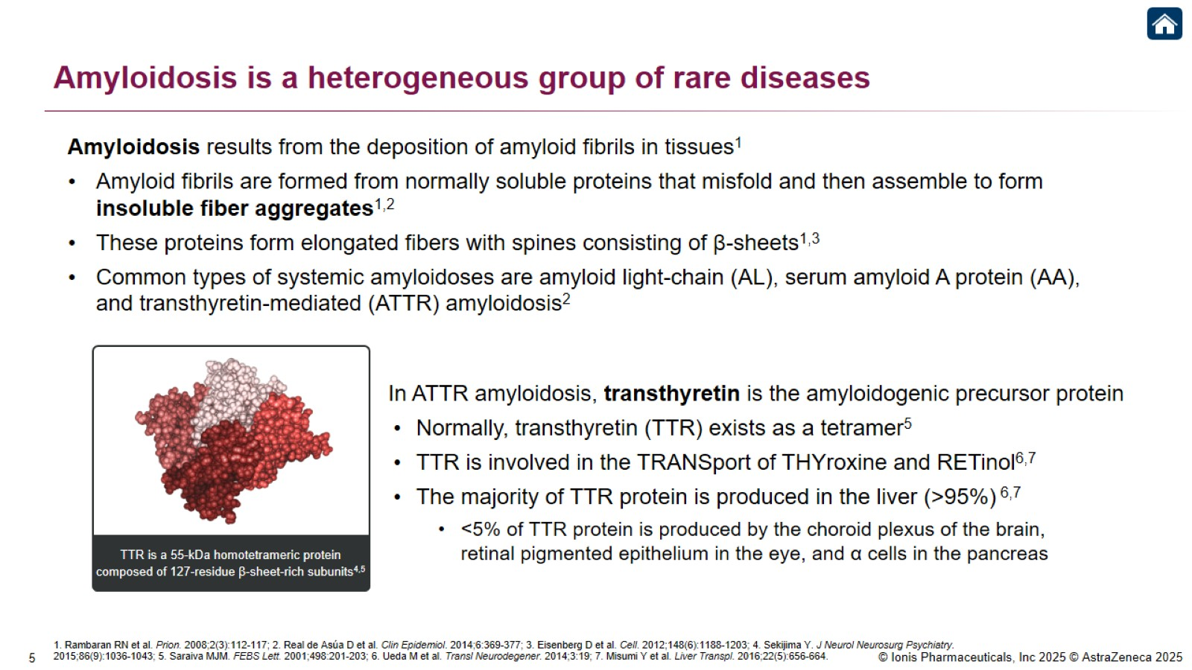
Amyloidosis is a heterogeneous group of rare diseases

Slide 7
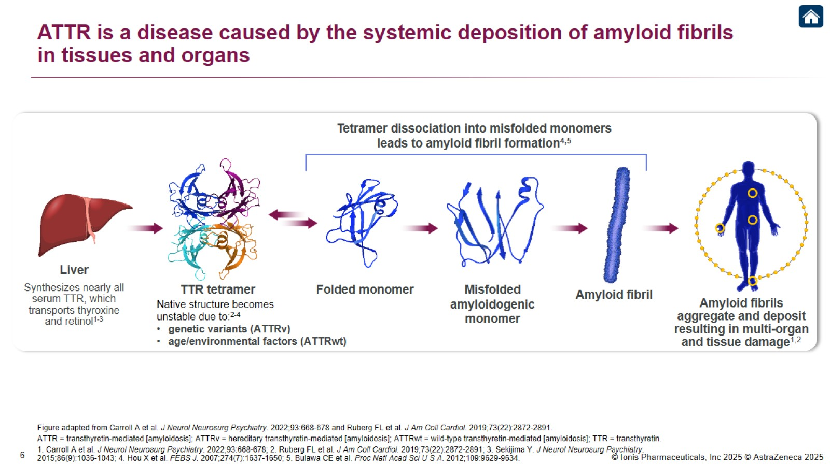
ATTR is a disease caused by the systemic deposition of amyloid fibrils in tissues and organs

Slide 8
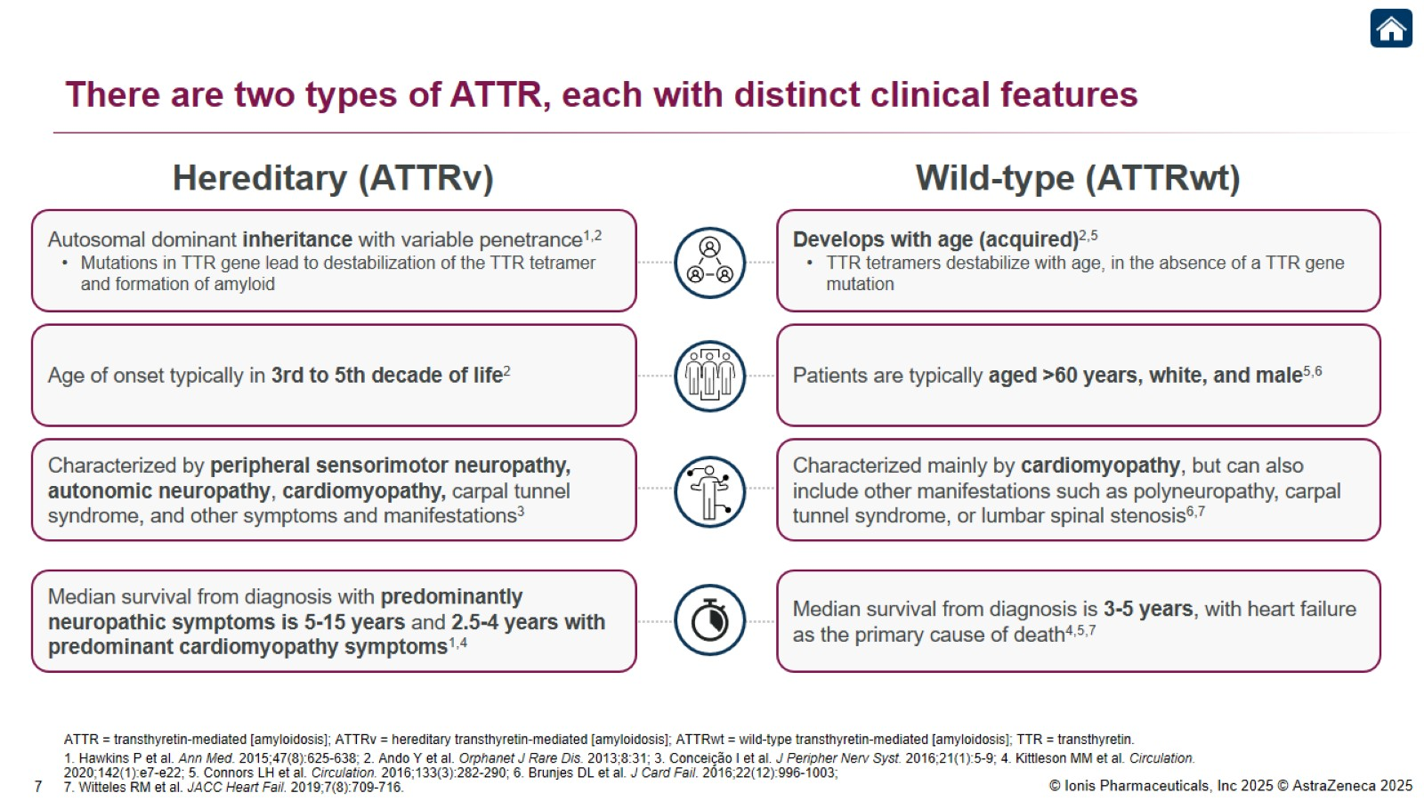
There are two types of ATTR, each with distinct clinical features

Slide 9
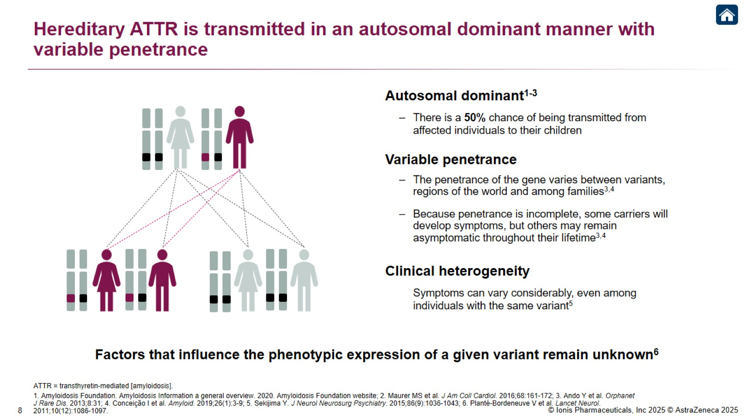
Hereditary ATTR is transmitted in an autosomal dominant manner with variable penetrance

Slide 10
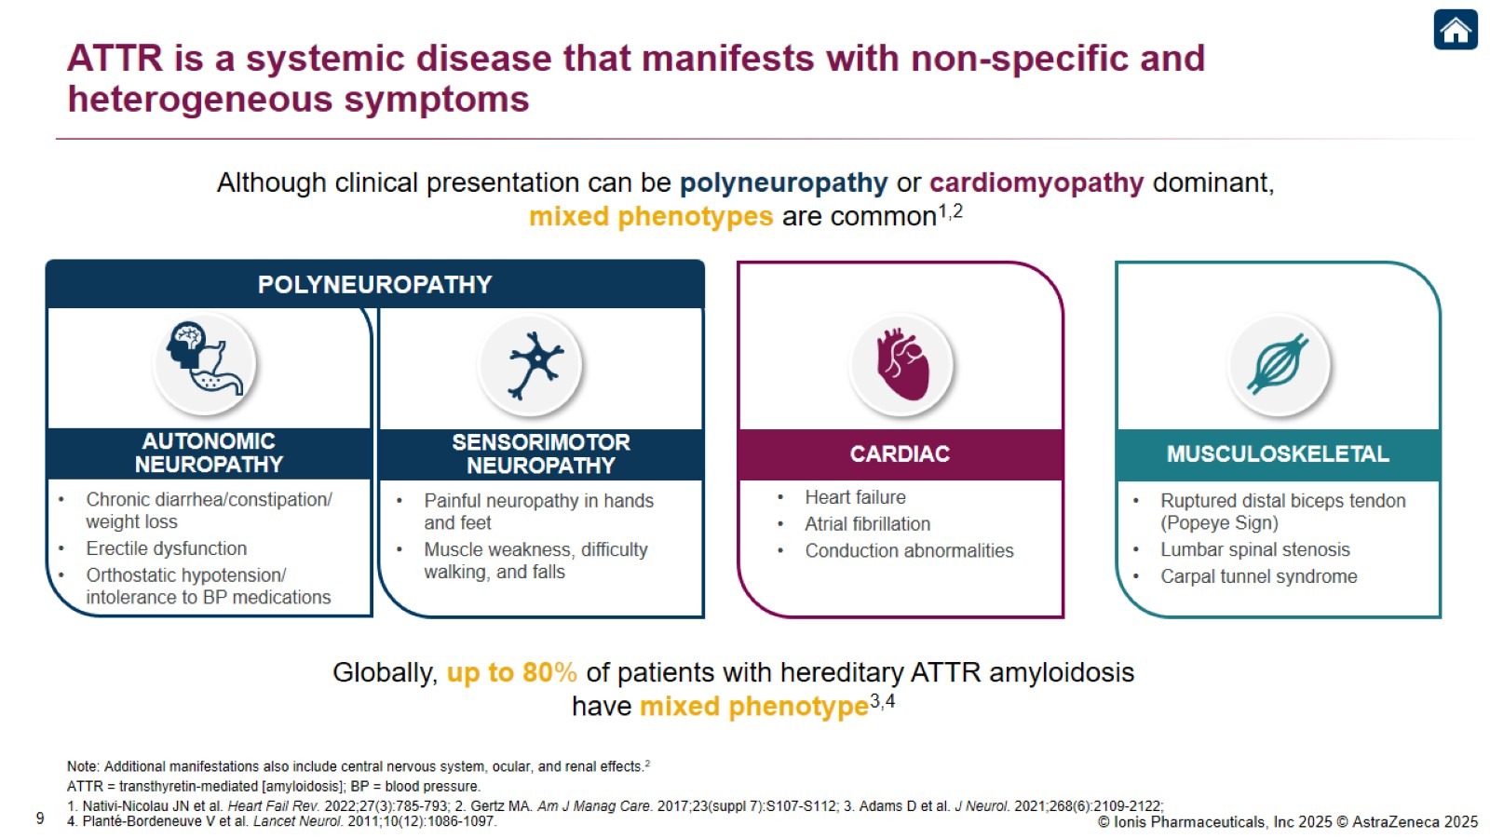
ATTR is a systemic disease that manifests with non-specific and heterogeneous symptoms

Slide 11
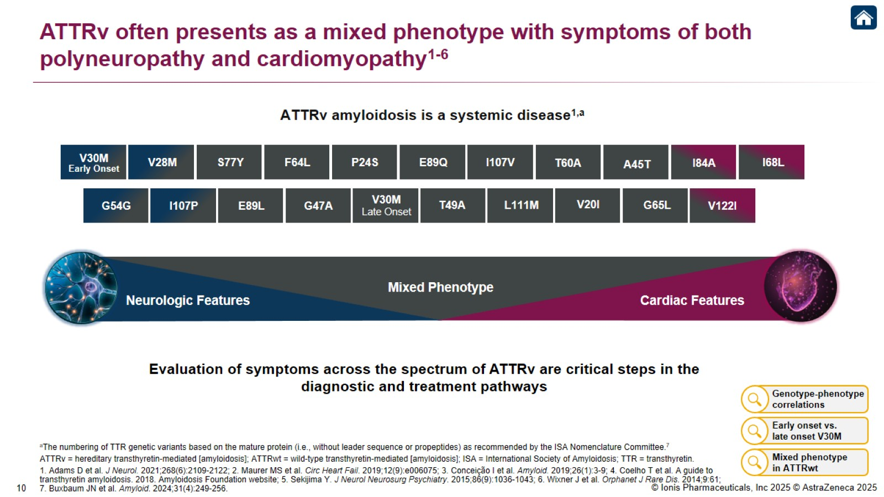
ATTRv often presents as a mixed phenotype with symptoms of both polyneuropathy and cardiomyopathy¹⁻⁶

Slide 12
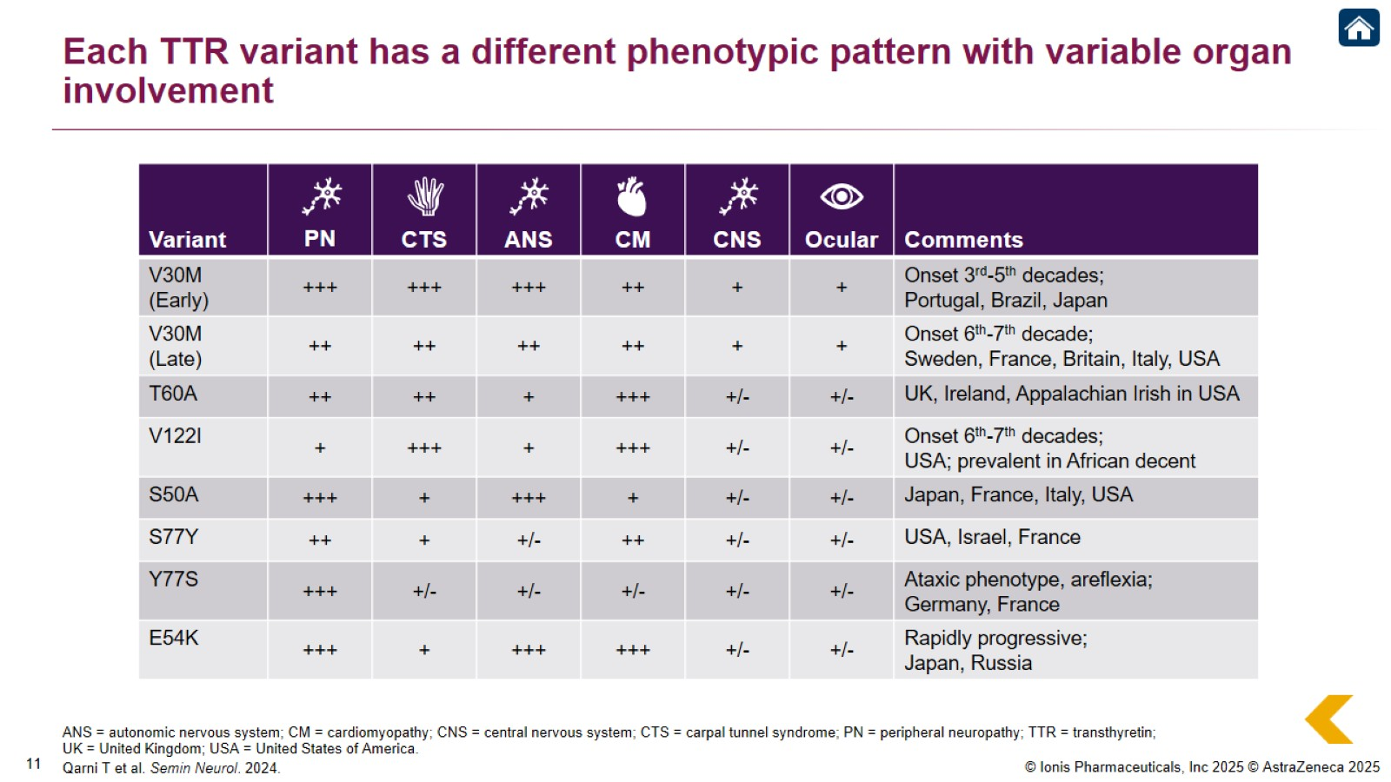
Each TTR variant has a different phenotypic pattern with variable organ involvement

Slide 13
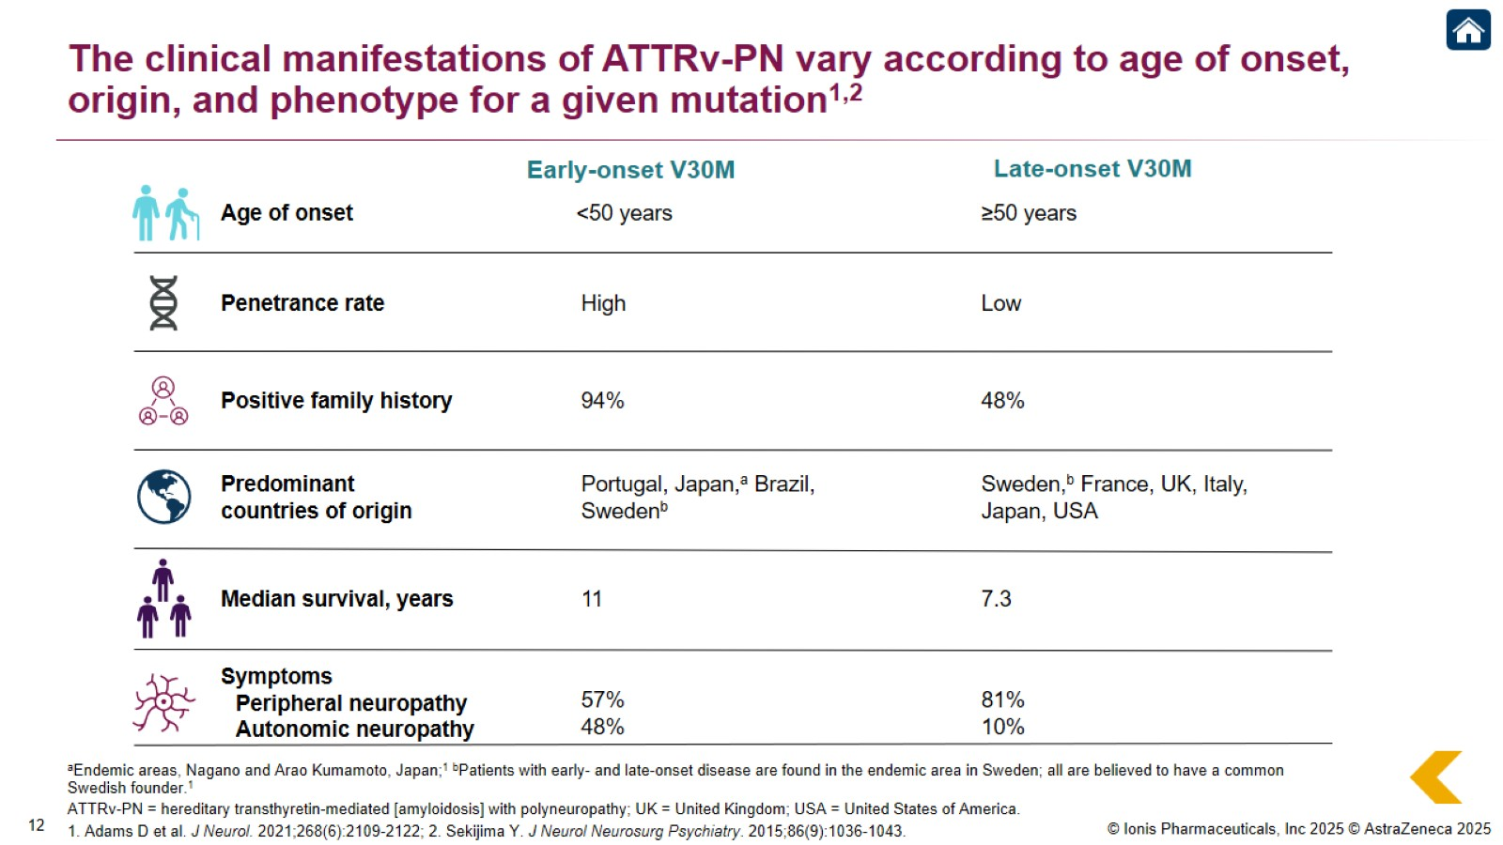
The clinical manifestations of ATTRv-PN vary according to age of onset, origin, and phenotype for a given mutation^{1,2}

Slide 14
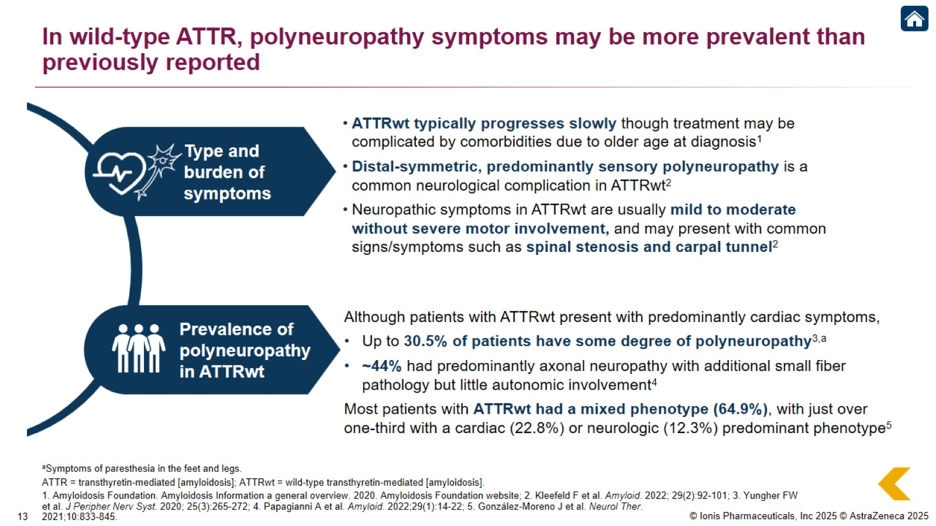
In wild-type ATTR, polyneuropathy symptoms may be more prevalent than previously reported

Slide 15
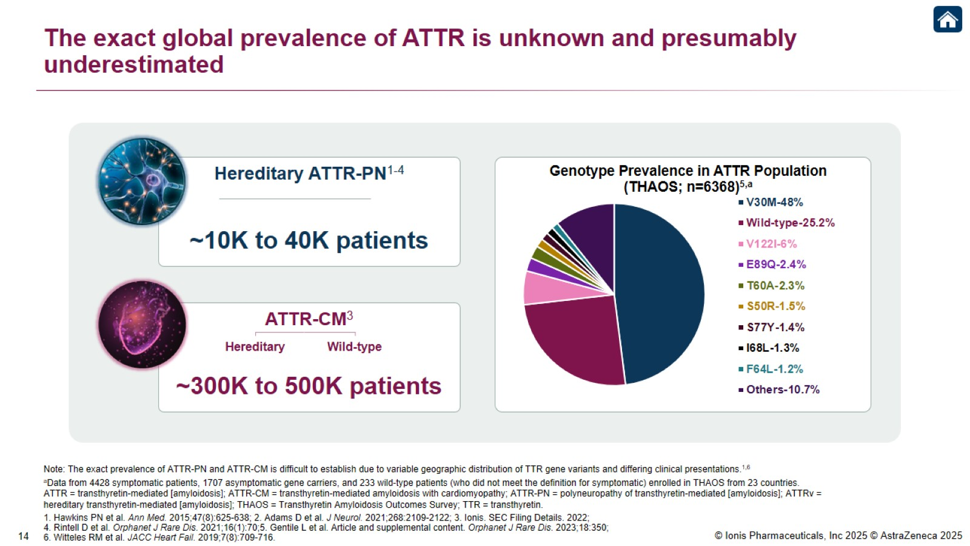
The exact global prevalence of ATTR is unknown and presumably underestimated

Slide 16
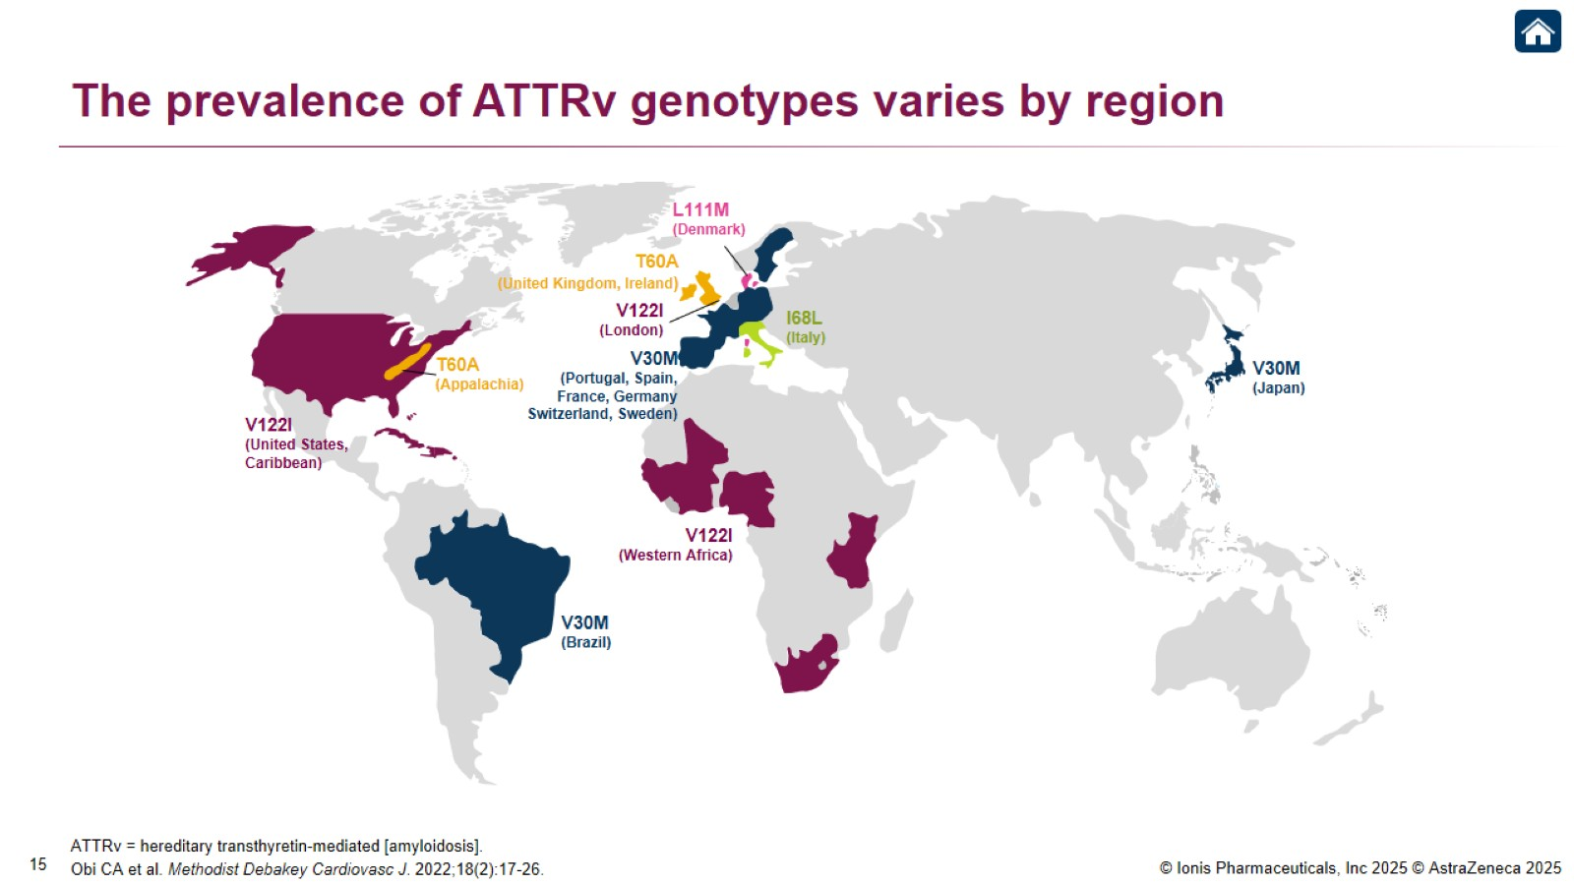
The prevalence of ATTRv genotypes varies by region

Slide 17
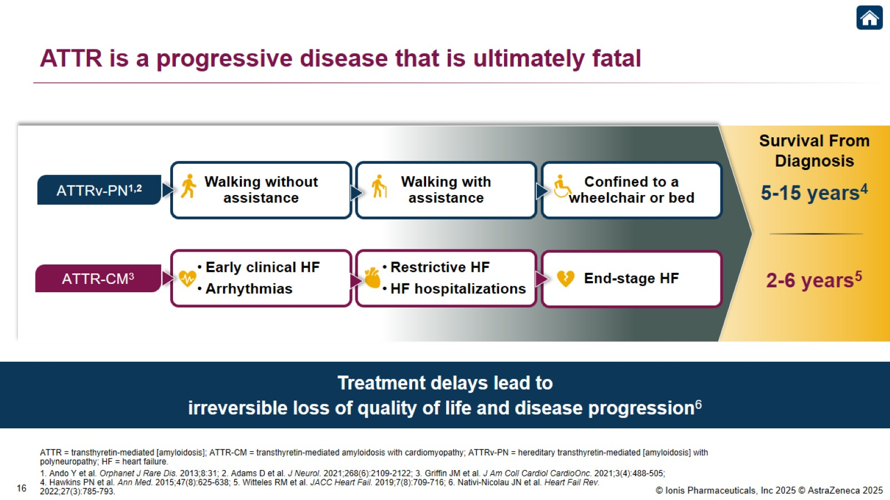
ATTR is a progressive disease that is ultimately fatal

Slide 18
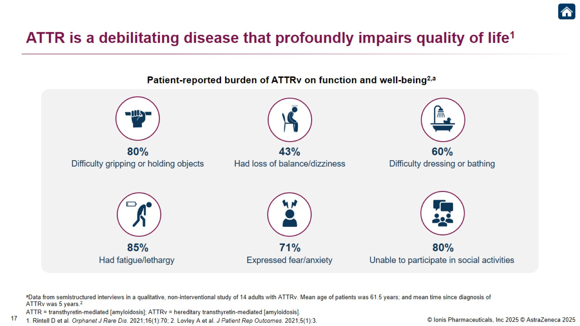
ATTR is a debilitating disease that profoundly impairs quality of life¹

Slide 19
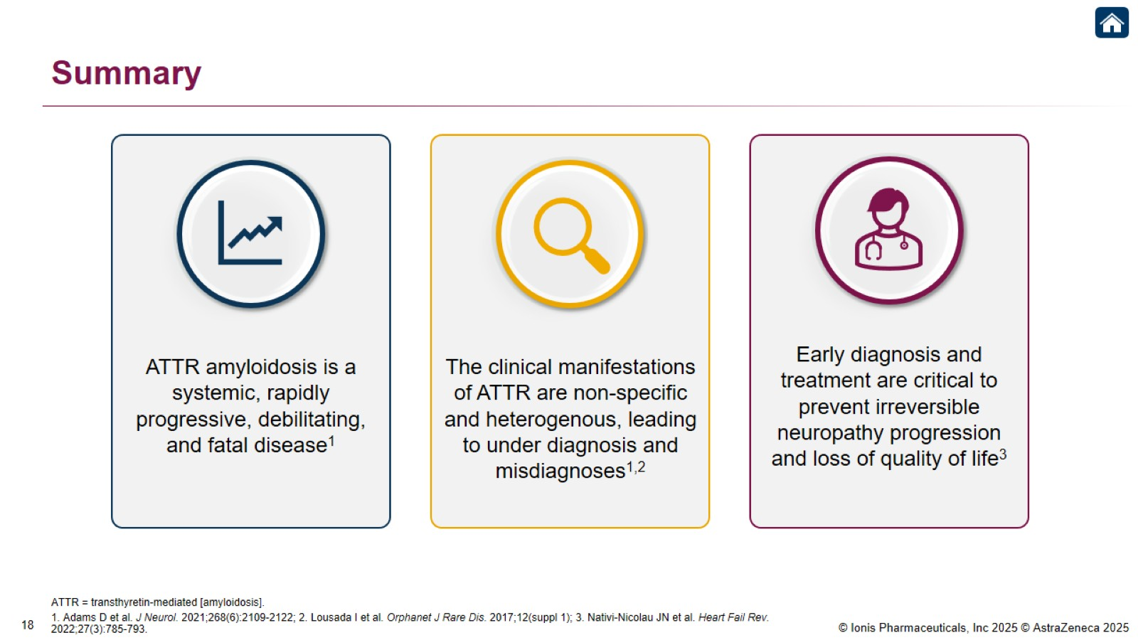
Summary

Slide 20

ATTR Amyloidosis Manifestations

Slide 21
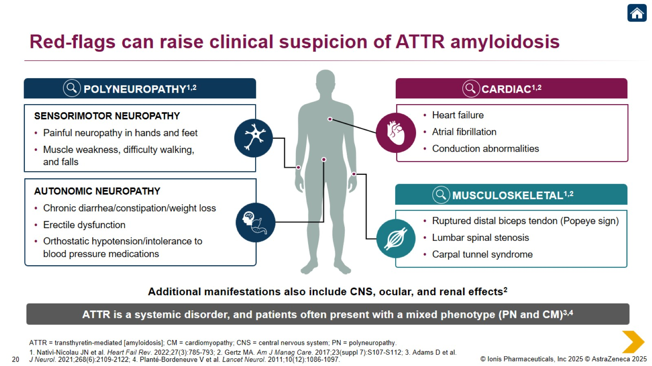
Red-flags can raise clinical suspicion of ATTR amyloidosis

Slide 22

Polyneuropathy Manifestations

Slide 23
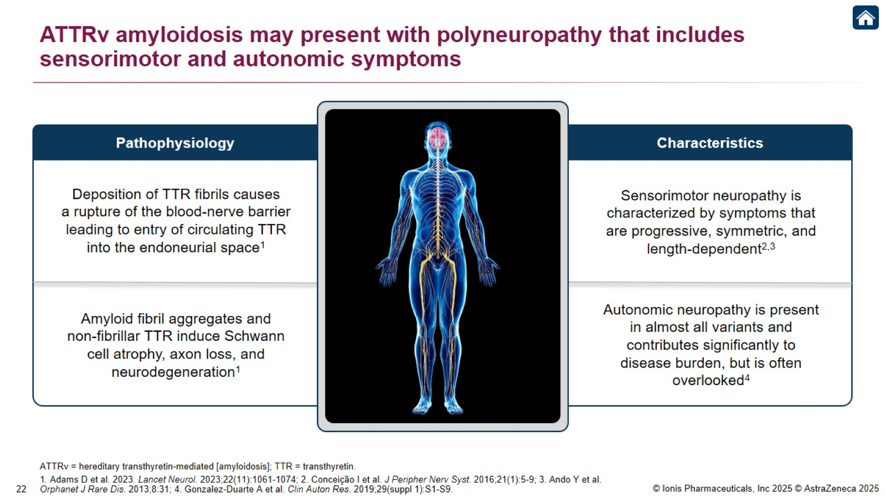
ATTRv amyloidosis may present with polyneuropathy that includes sensorimotor and autonomic symptoms

Slide 24
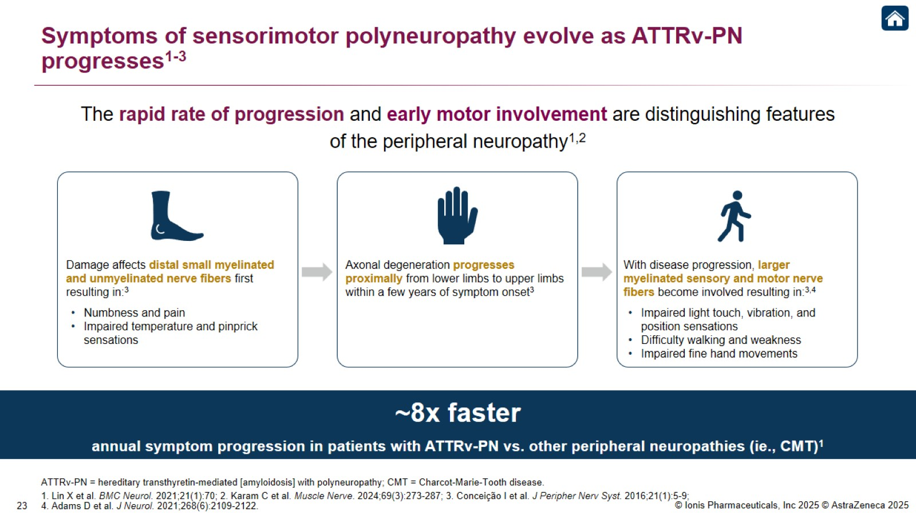
Symptoms of sensorimotor polyneuropathy evolve as ATTRv-PN progresses¹⁻³

Slide 25
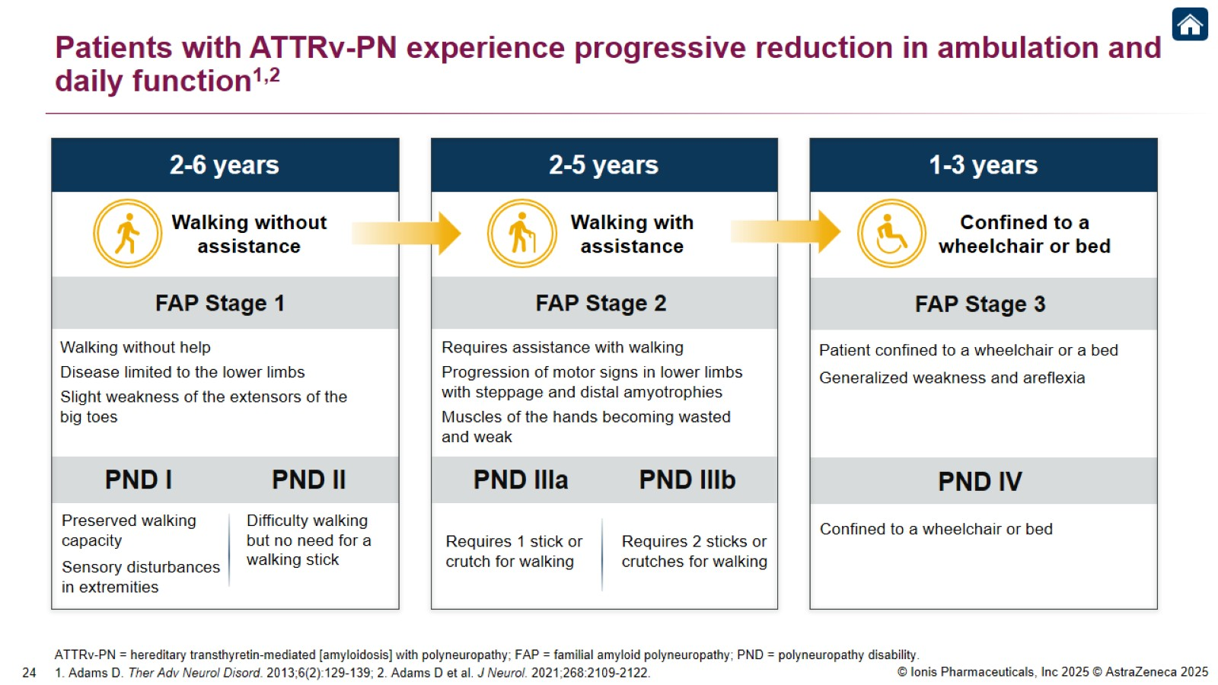
Patients with ATTRv-PN experience progressive reduction in ambulation and daily function^{1,2}

Slide 26
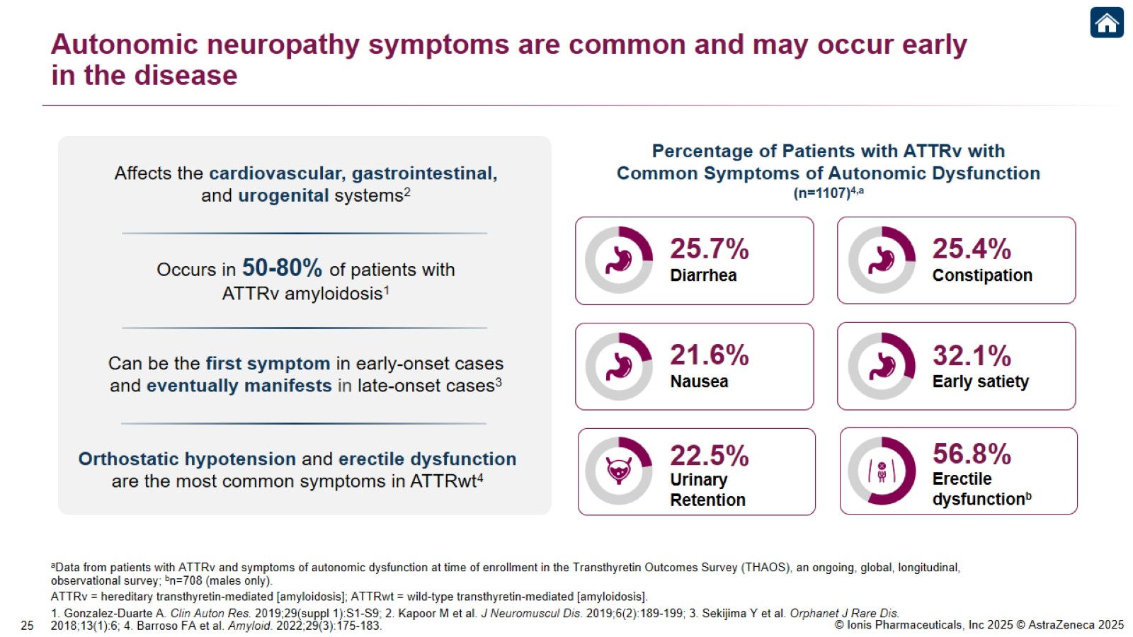
Autonomic neuropathy symptoms are common and may occur early in the disease

Slide 27
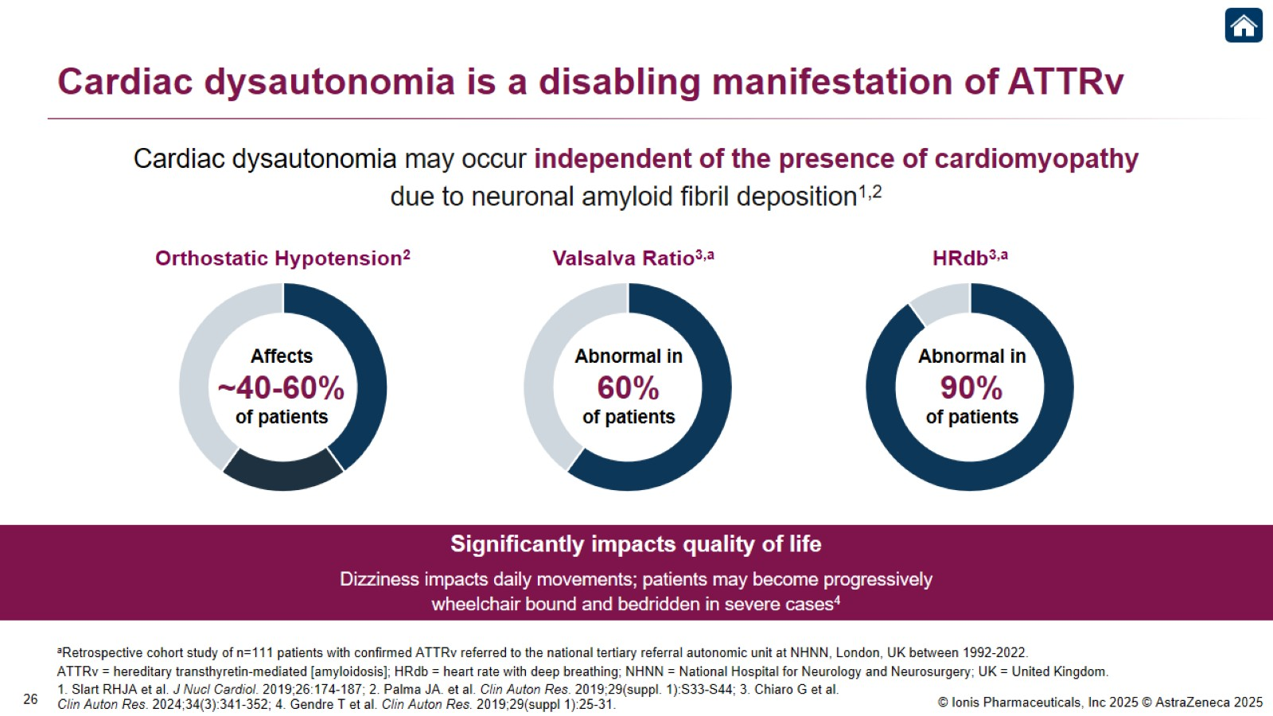
Cardiac dysautonomia is a disabling manifestation of ATTRv

Slide 28
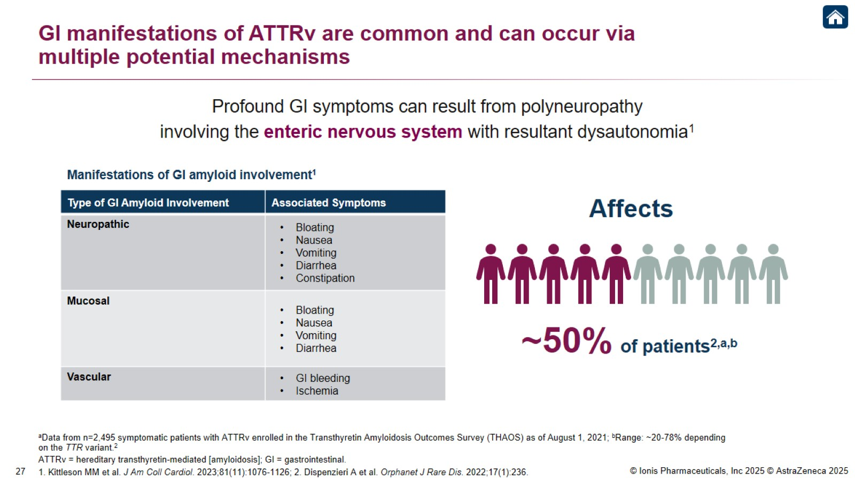
GI manifestations of ATTRv are common and can occur via multiple potential mechanisms

Slide 29
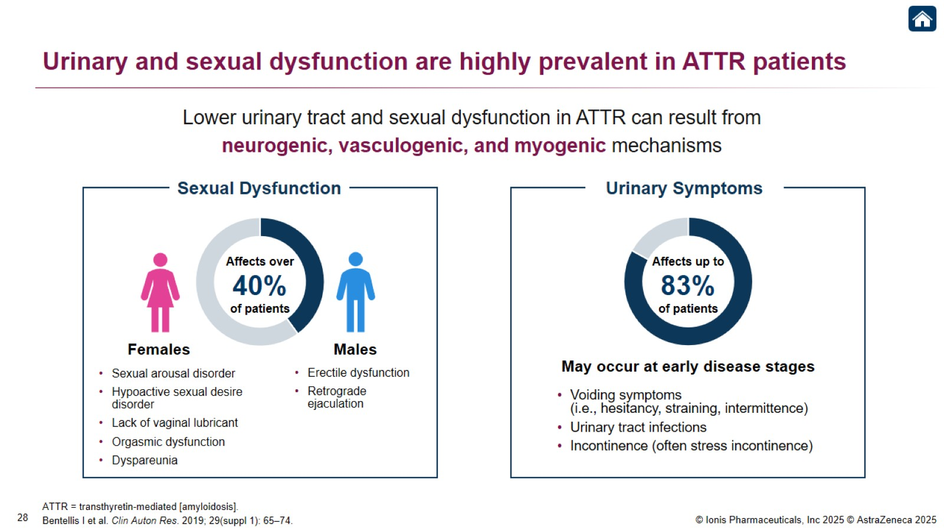
Urinary and sexual dysfunction are highly prevalent in ATTR patients

Slide 30
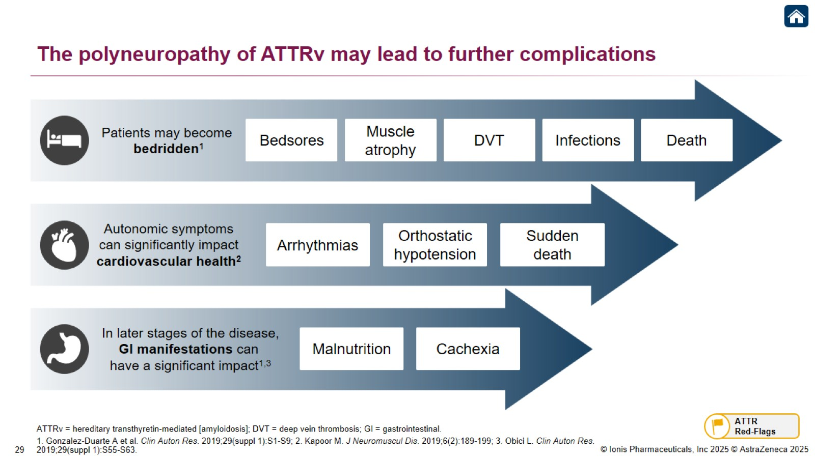
The polyneuropathy of ATTRv may lead to further complications

Slide 31

Cardiac Manifestations

Slide 32
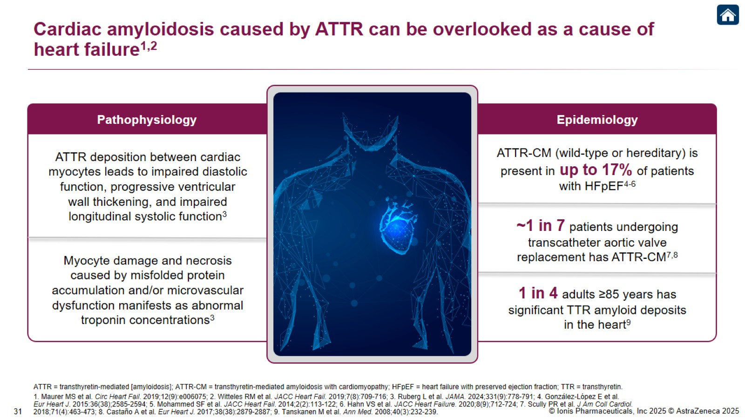
Cardiac amyloidosis caused by ATTR can be overlooked as a cause of heart failure^{1,2}

Slide 33
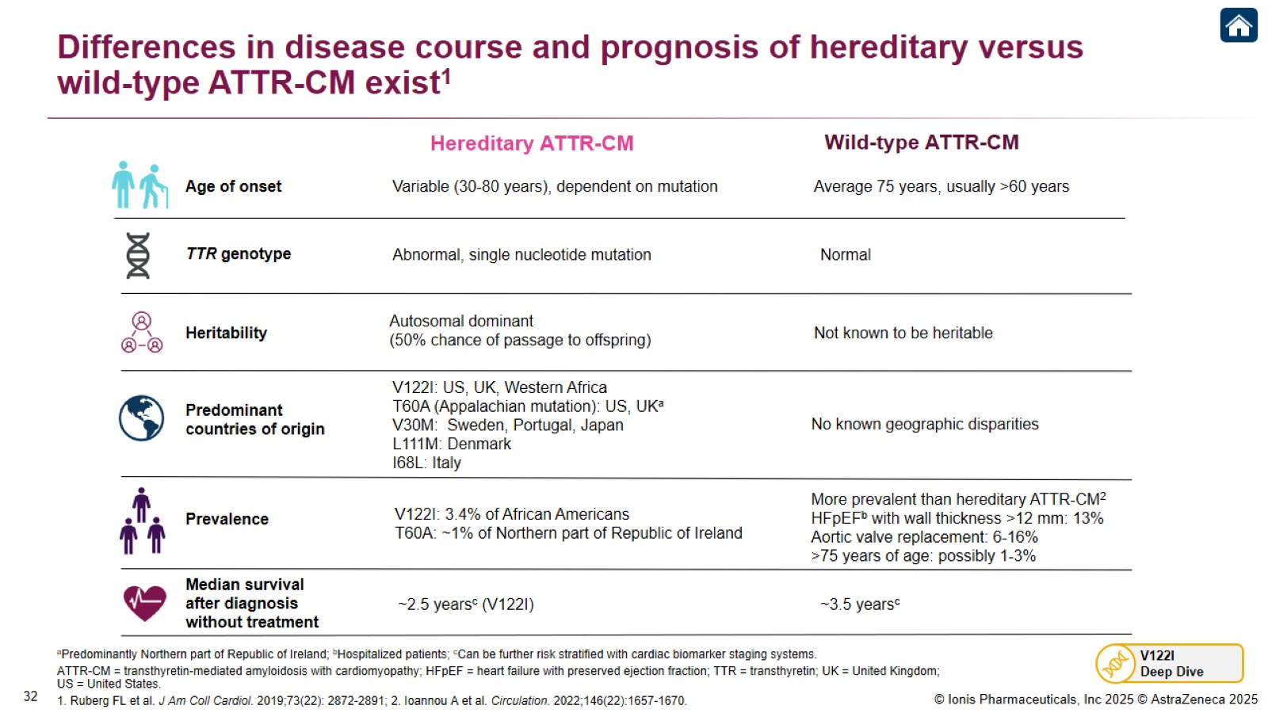
Differences in disease course and prognosis of hereditary versus wild-type ATTR-CM exist¹

Slide 34
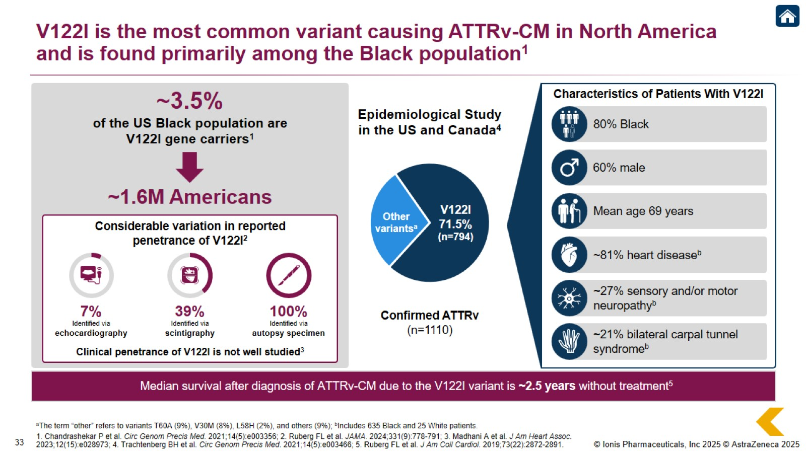
V122I is the most common variant causing ATTRv-CM in North America and is found primarily among the Black population¹

Slide 35
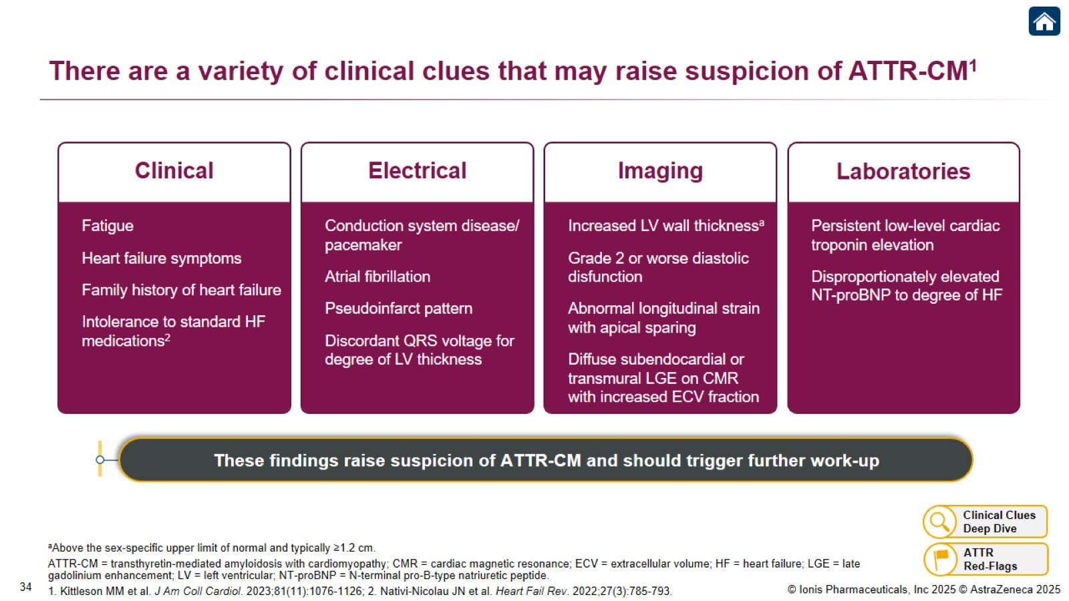
There are a variety of clinical clues that may raise suspicion of ATTR-CM¹

Slide 36
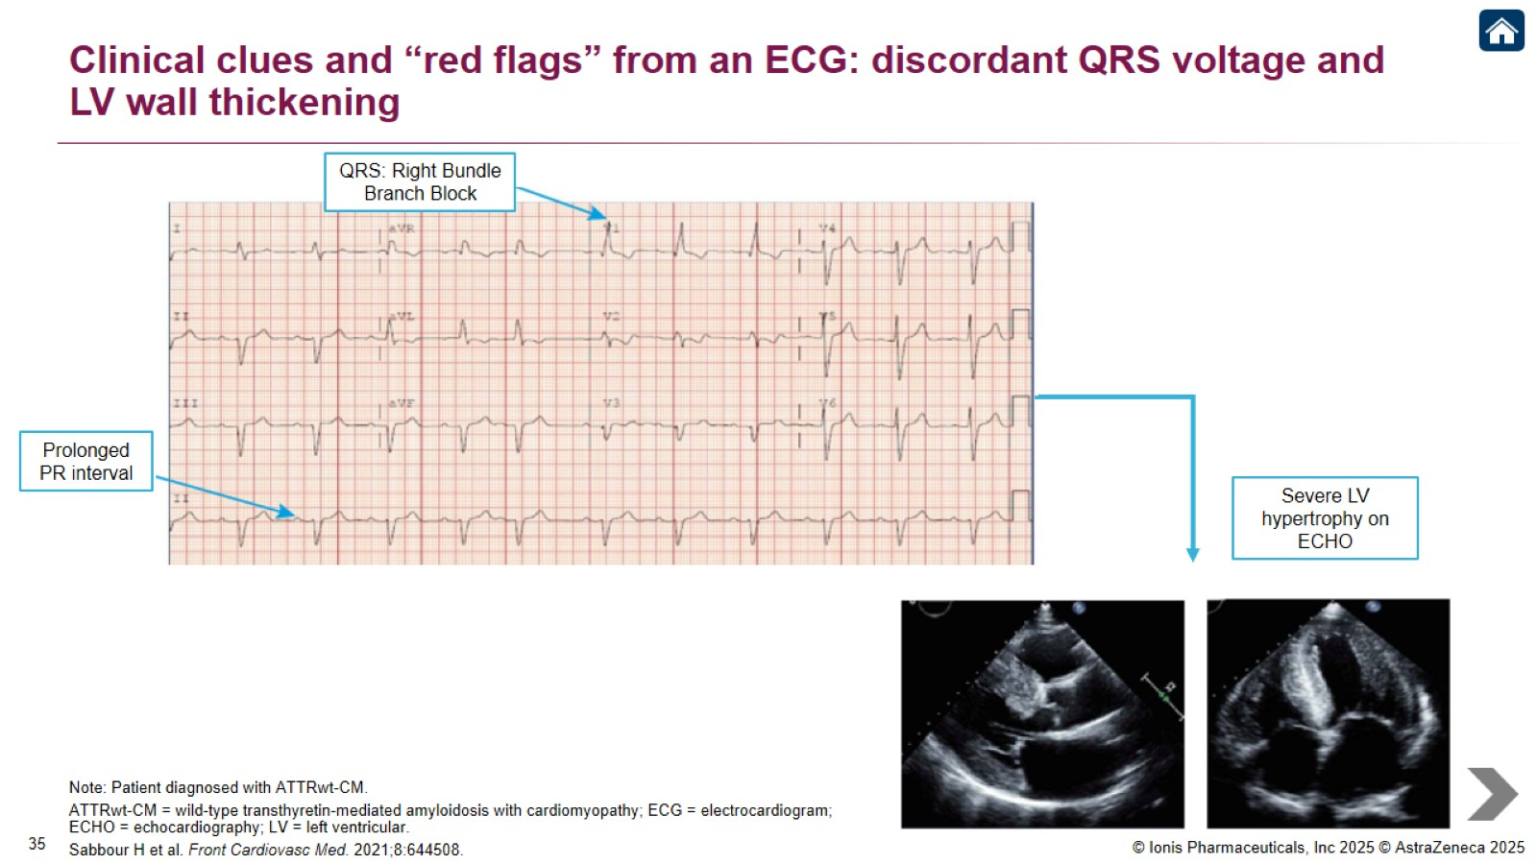
Clinical clues and “red flags” from an ECG: discordant QRS voltage and LV wall thickening

Slide 37
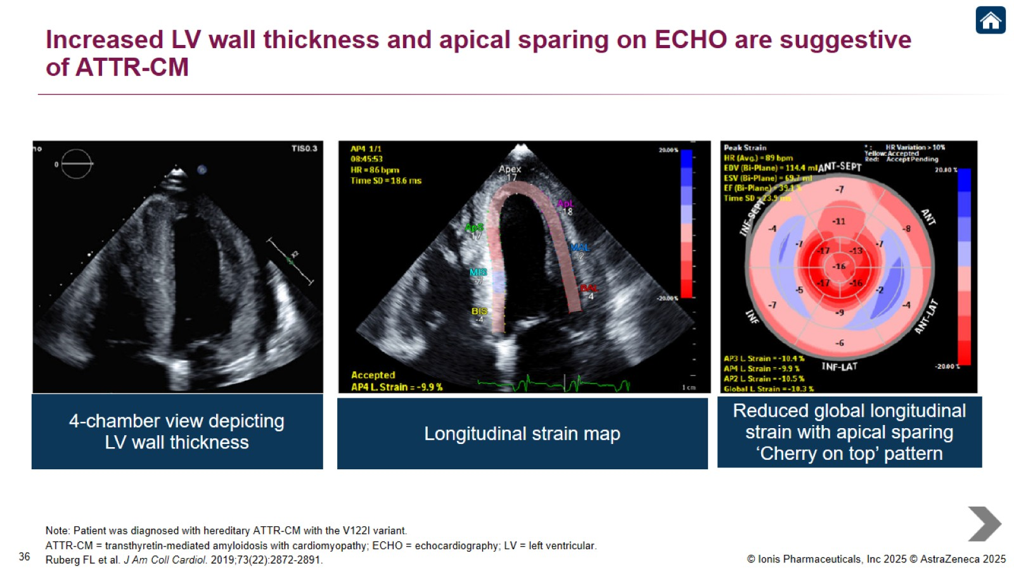
Increased LV wall thickness and apical sparing on ECHO are suggestive of ATTR-CM

Slide 38
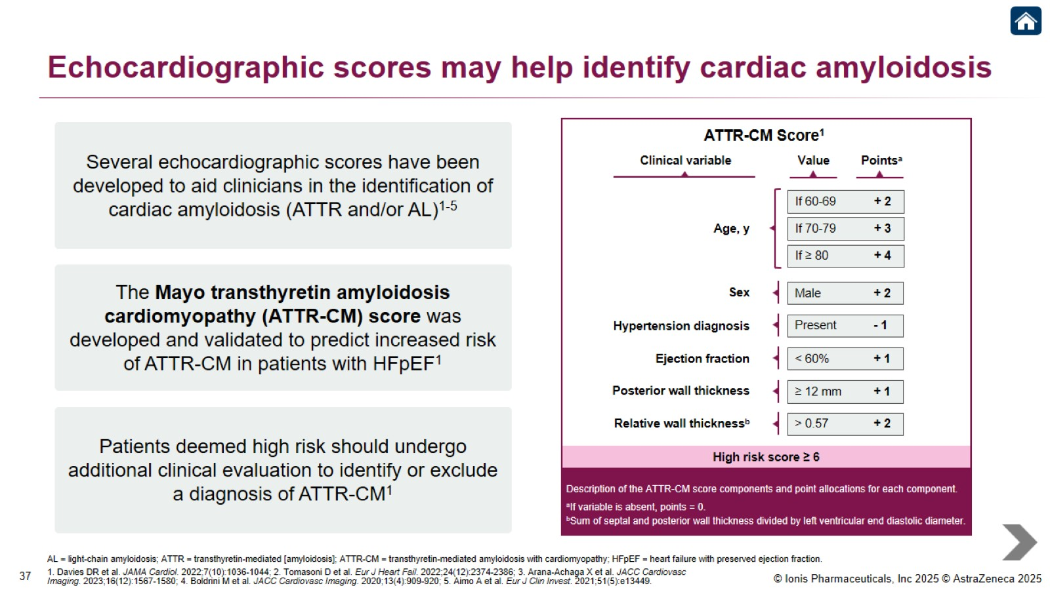
Echocardiographic scores may help identify cardiac amyloidosis

Slide 39
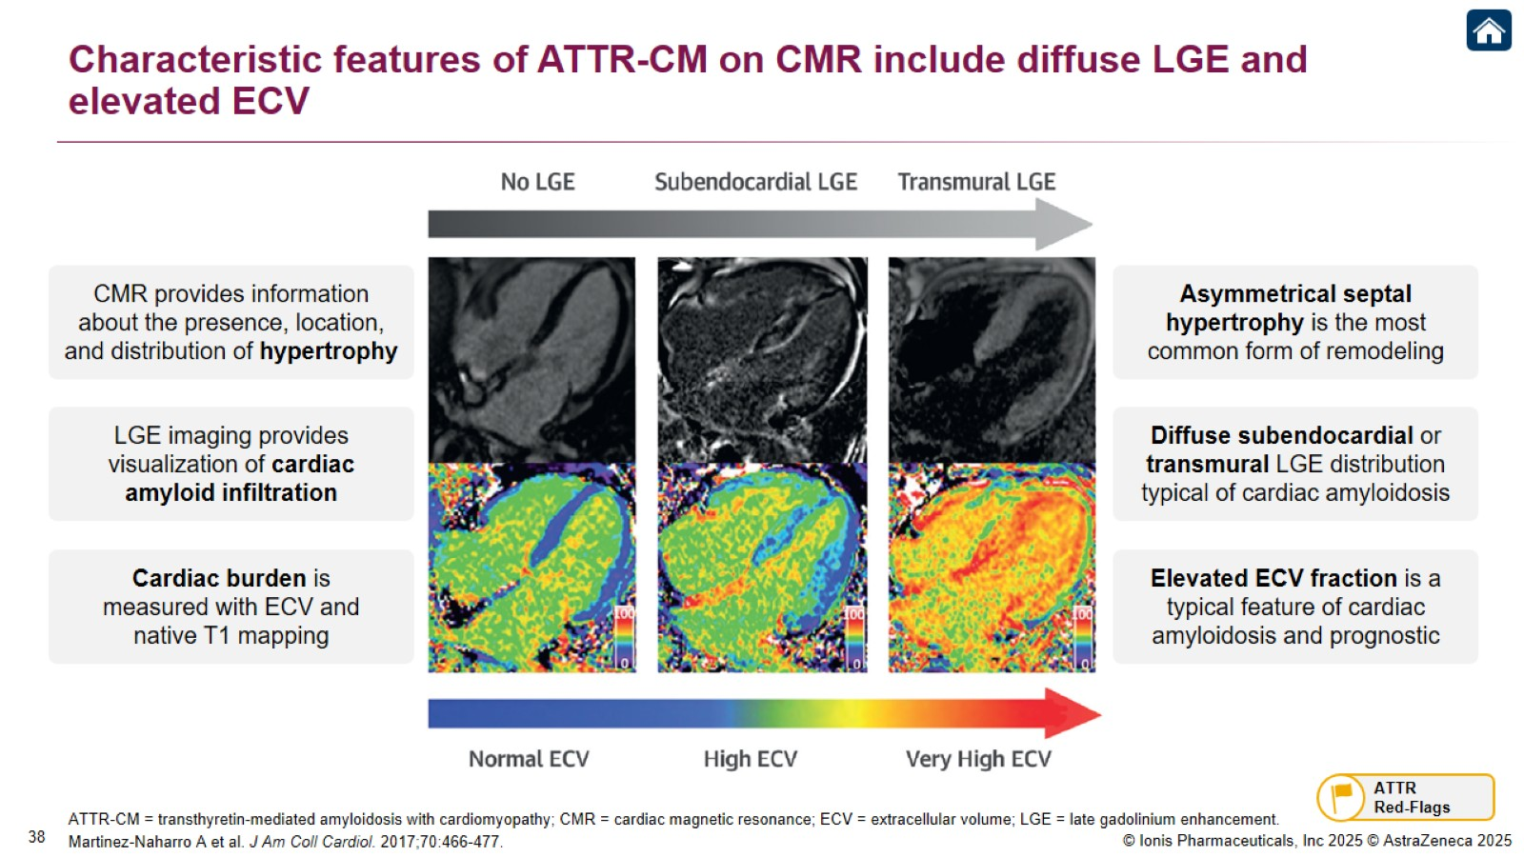
Characteristic features of ATTR-CM on CMR include diffuse LGE and elevated ECV

Slide 40

Musculoskeletal Manifestations

Slide 41
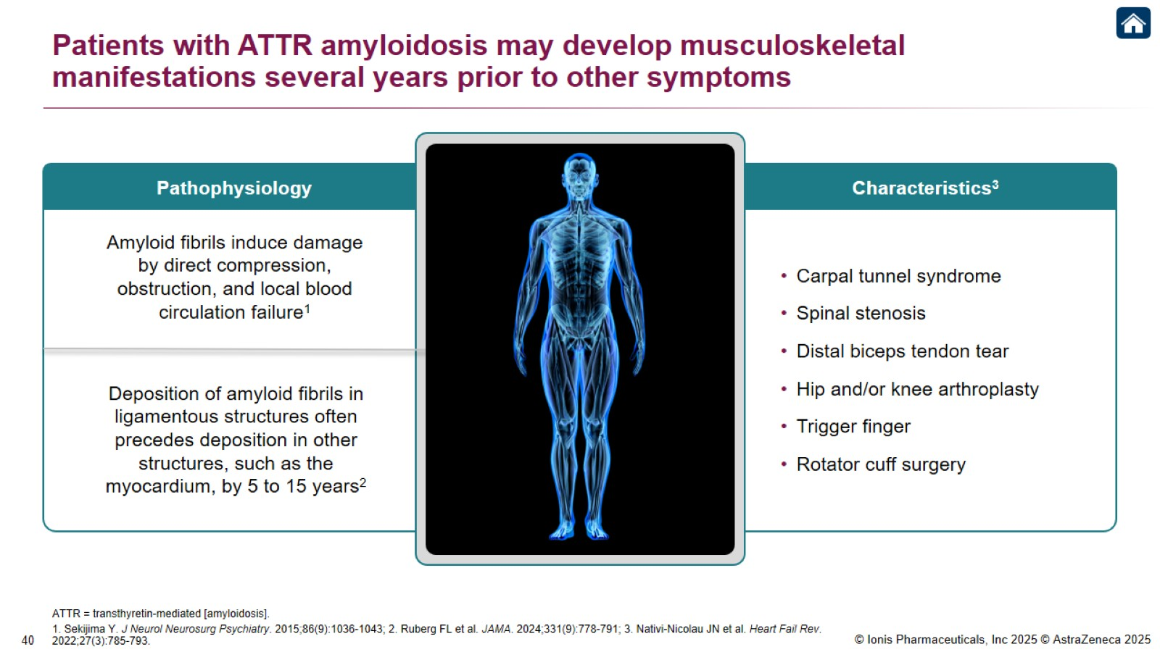
Patients with ATTR amyloidosis may develop musculoskeletal manifestations several years prior to other symptoms

Slide 42
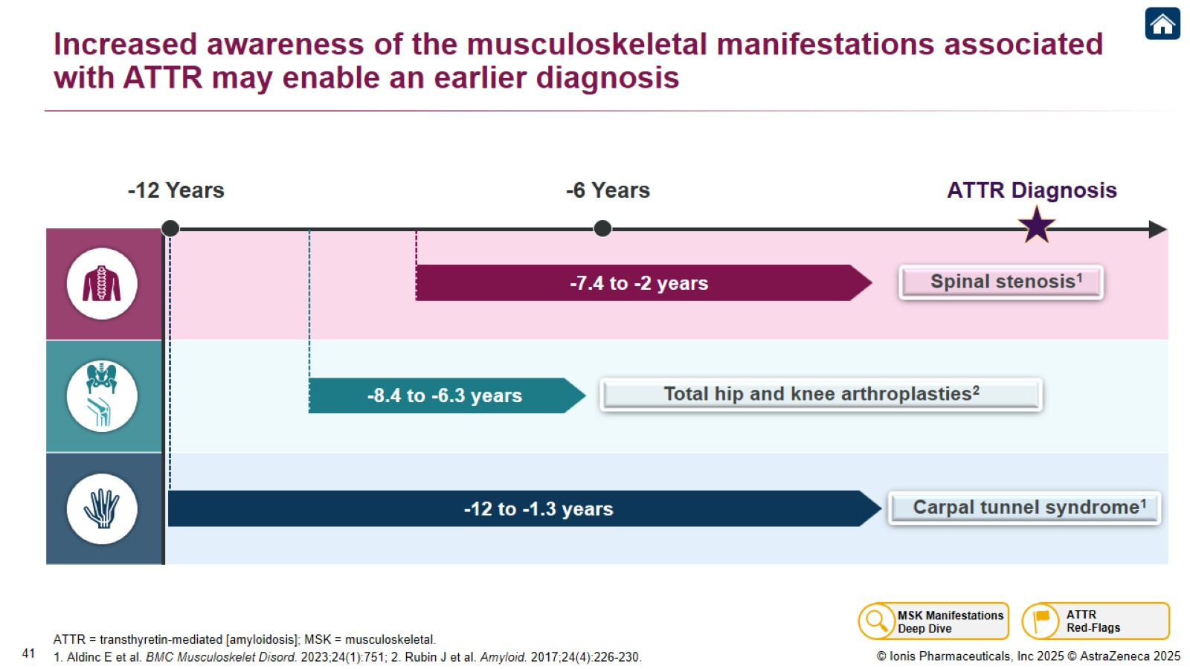
Increased awareness of the musculoskeletal manifestations associated with ATTR may enable an earlier diagnosis

Slide 43
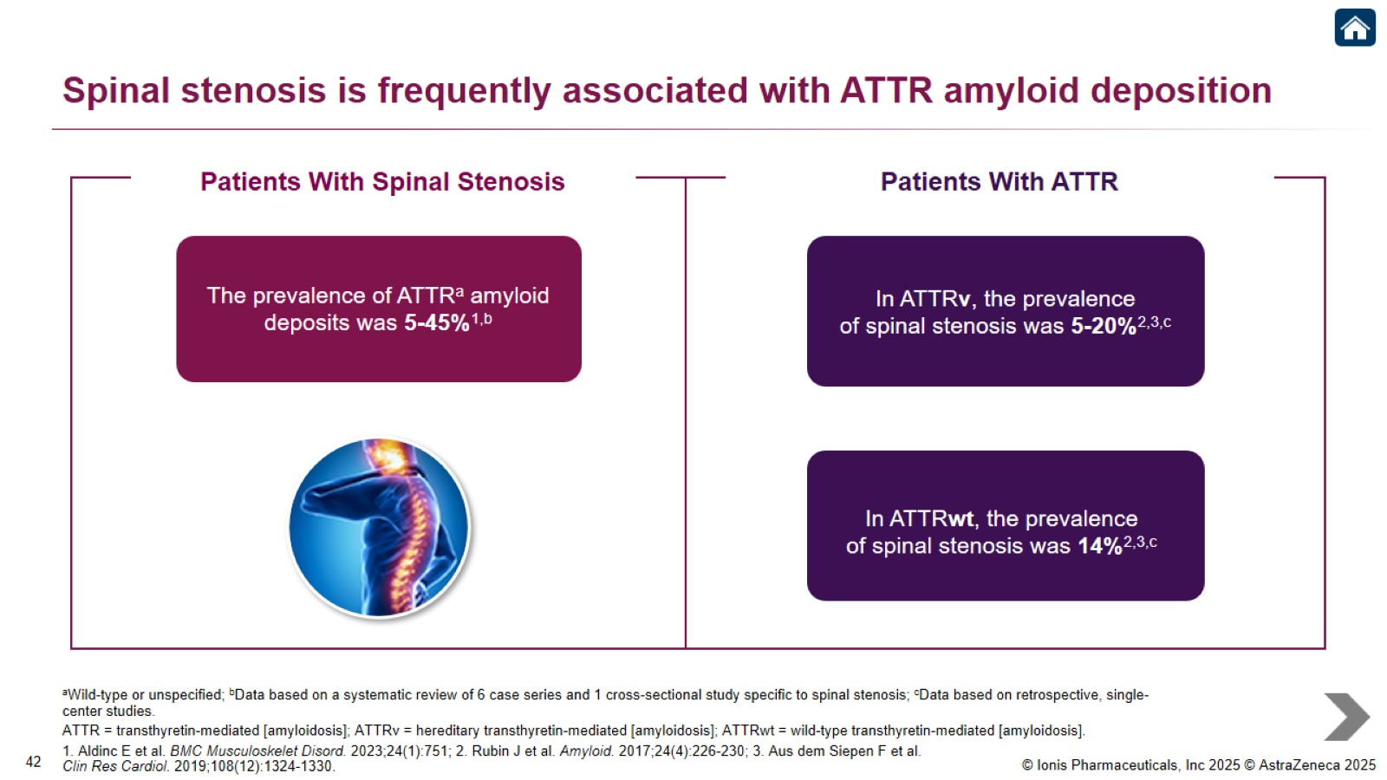
Spinal stenosis is frequently associated with ATTR amyloid deposition

Slide 44
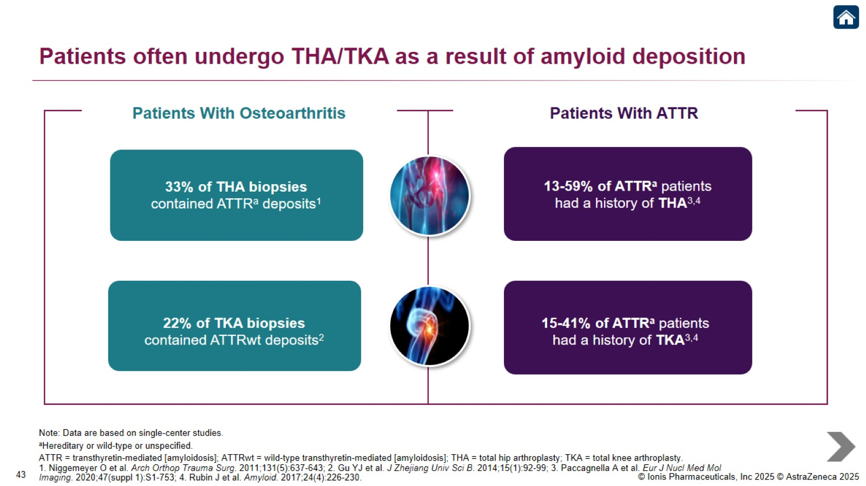
Patients often undergo THA/TKA as a result of amyloid deposition

Slide 45
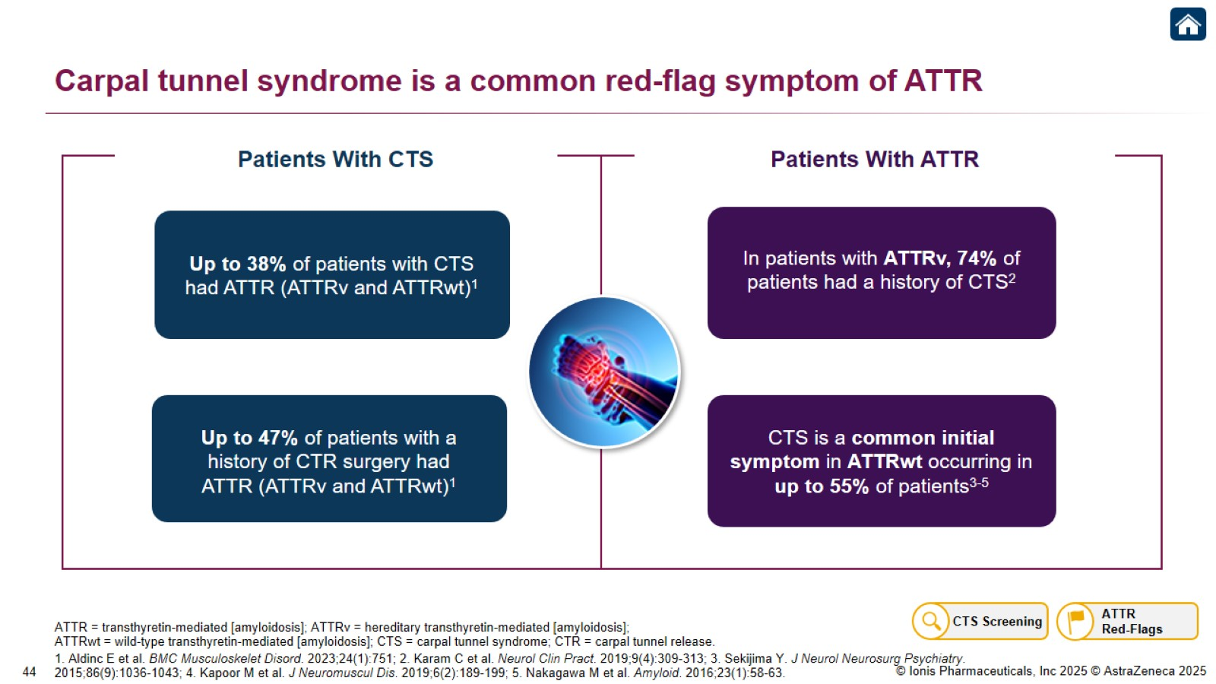
Carpal tunnel syndrome is a common red-flag symptom of ATTR

Slide 46
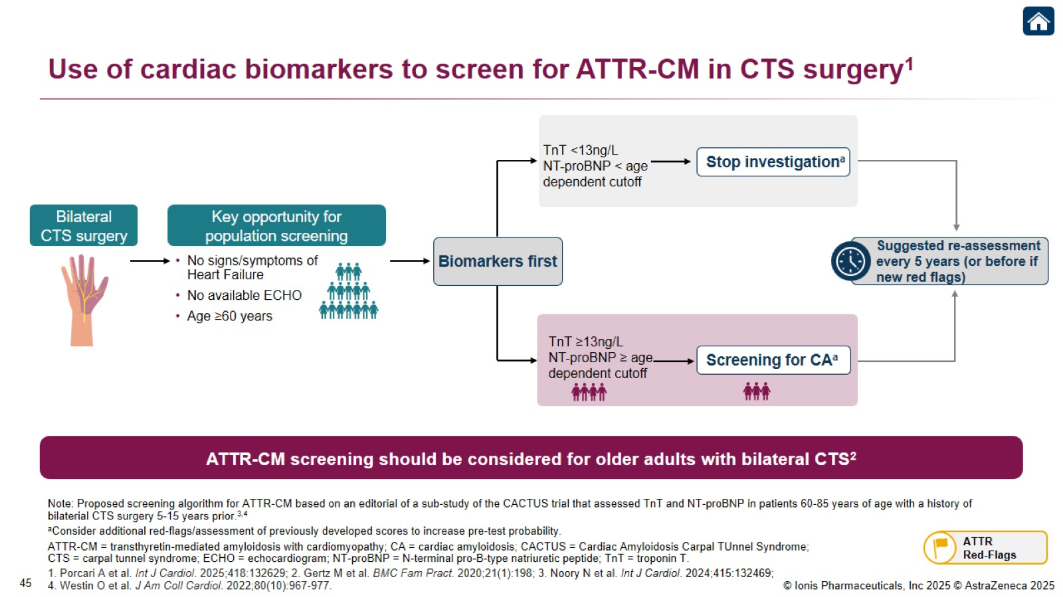
Use of cardiac biomarkers to screen for ATTR-CM in CTS surgery¹

Slide 47
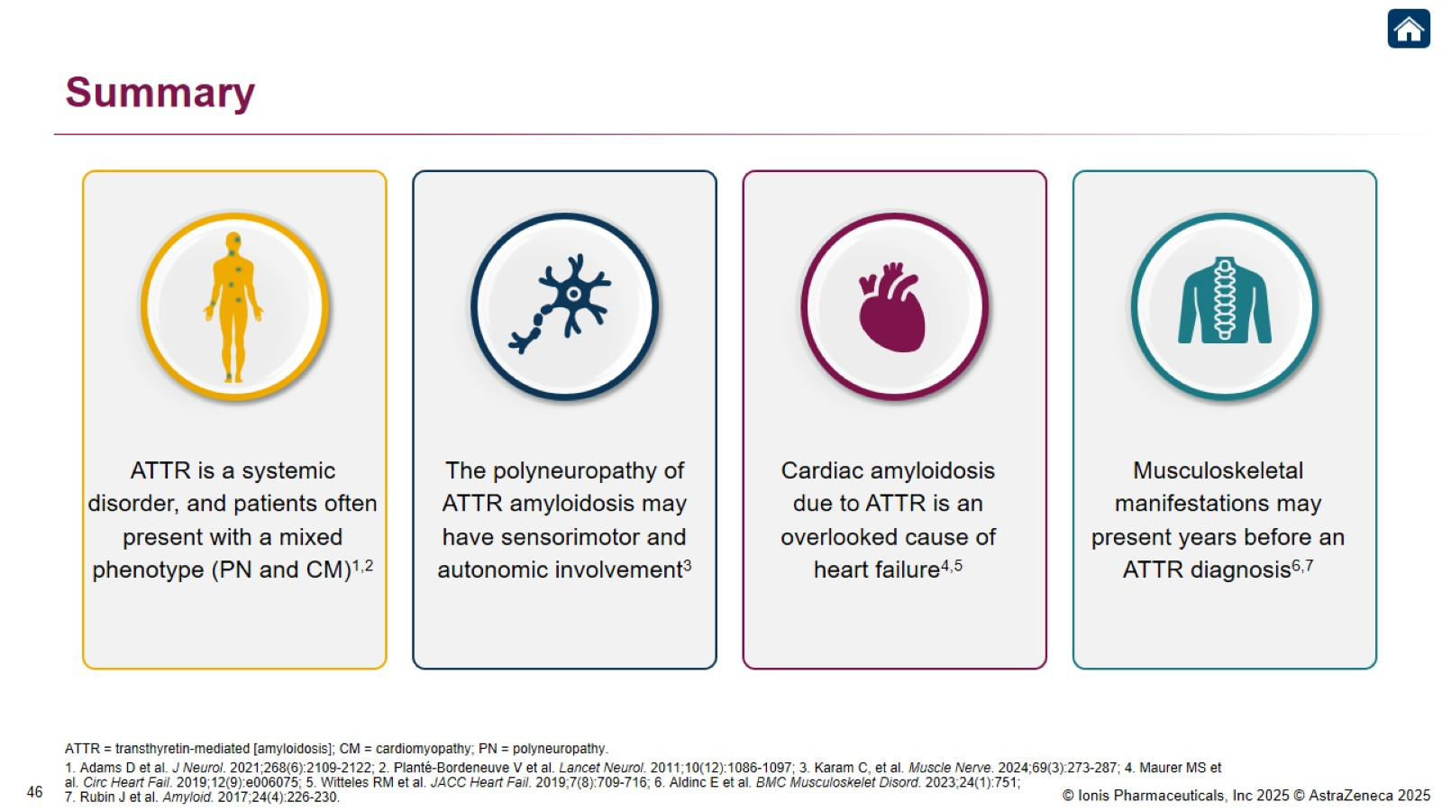
Summary

Slide 48
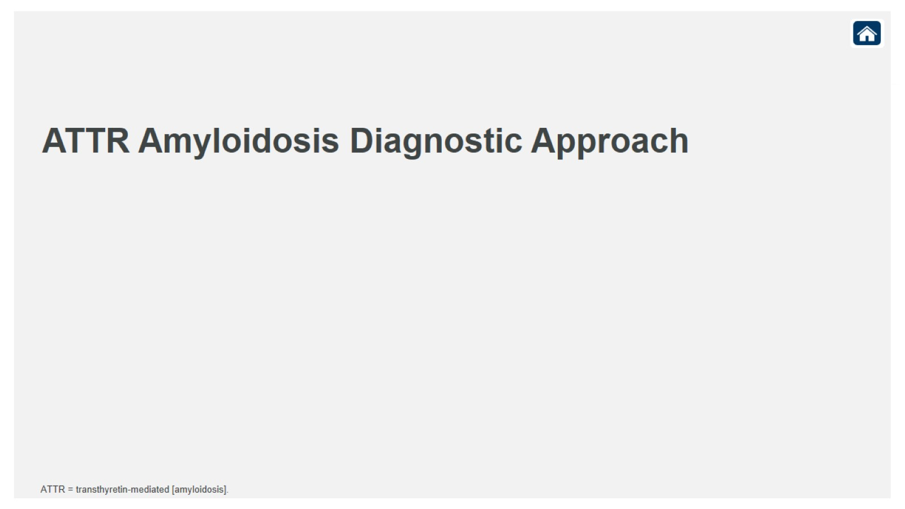
ATTR Amyloidosis Diagnostic Approach

Slide 49
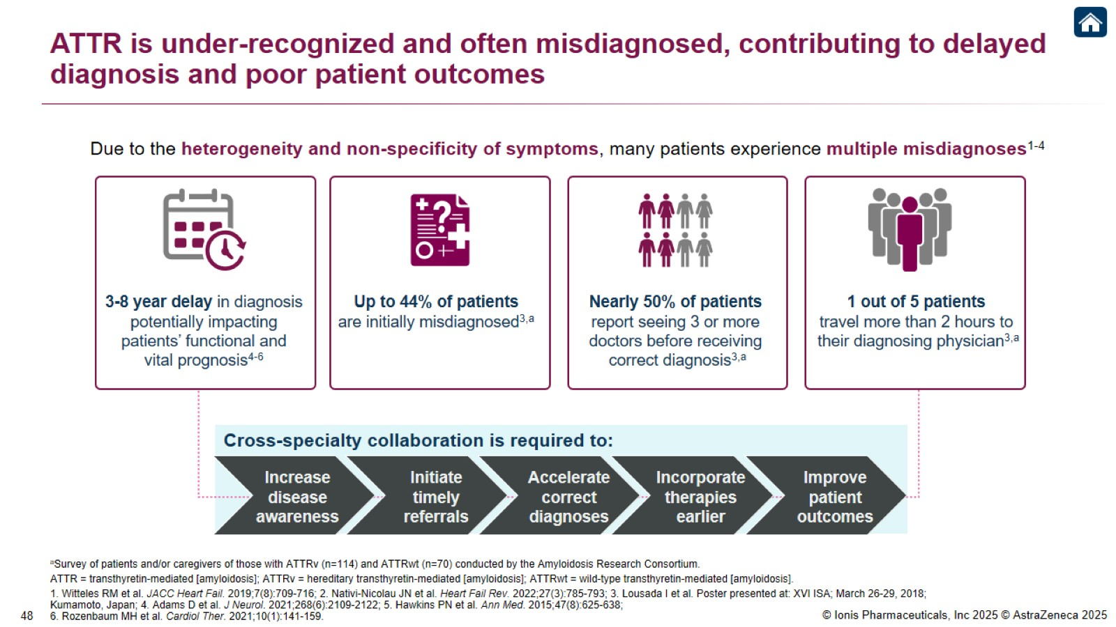
ATTR is under-recognized and often misdiagnosed, contributing to delayed diagnosis and poor patient outcomes

Slide 50
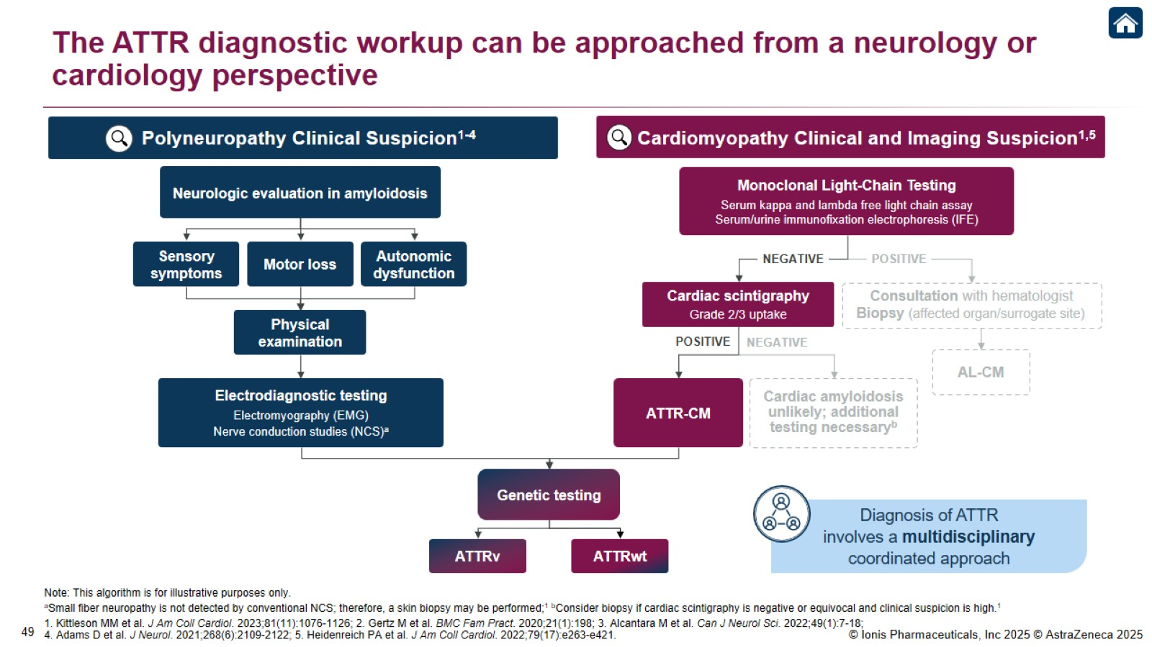
The ATTR diagnostic workup can be approached from a neurology or cardiology perspective

Slide 51
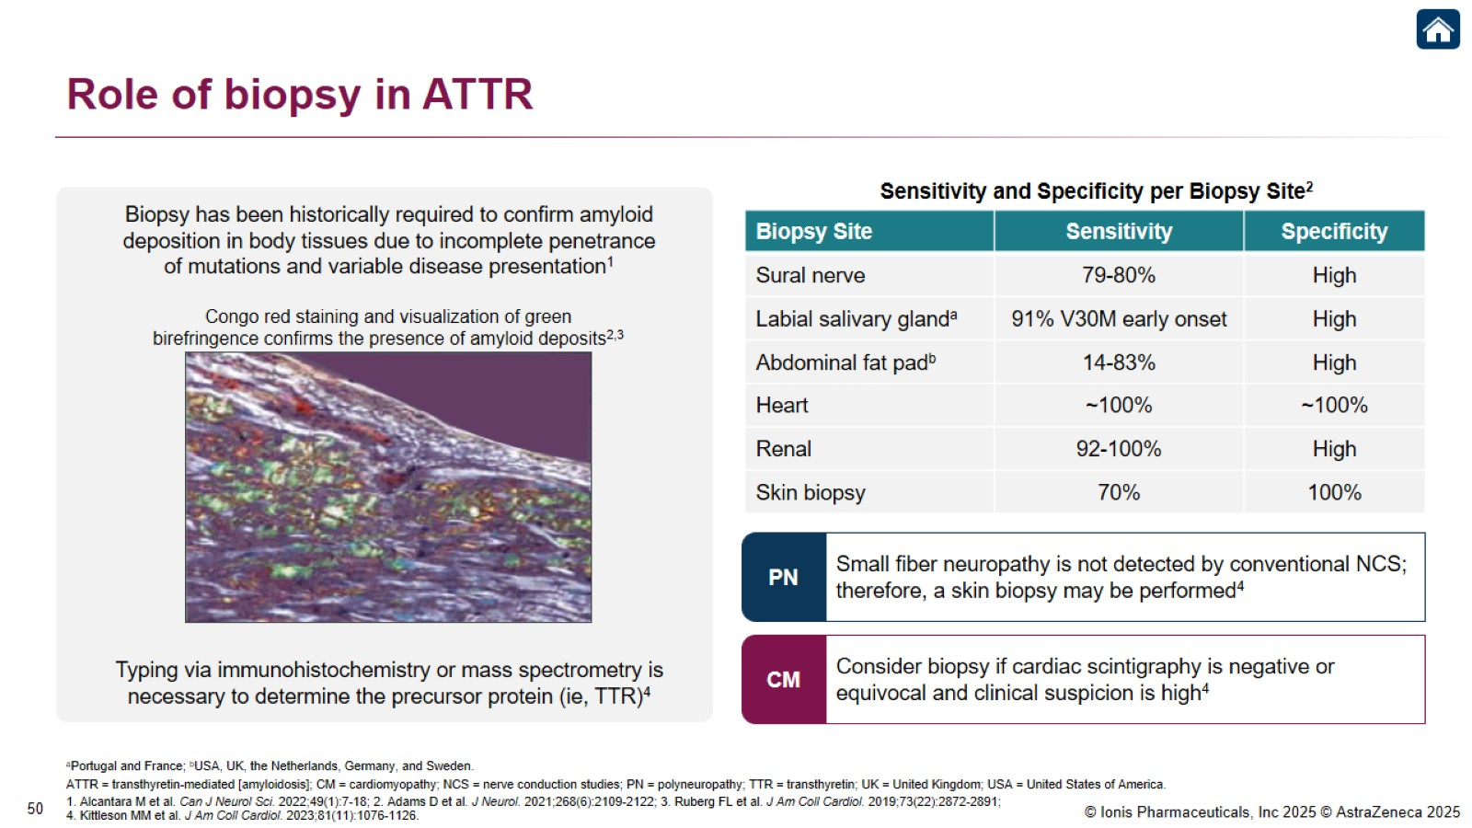
Role of biopsy in ATTR

Slide 52
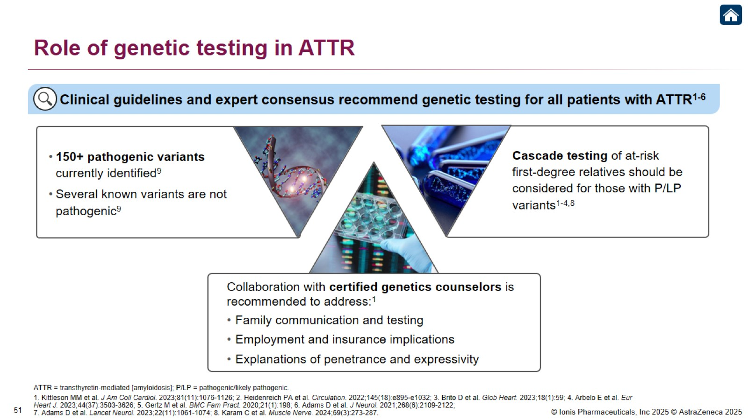
Role of genetic testing in ATTR

Slide 53
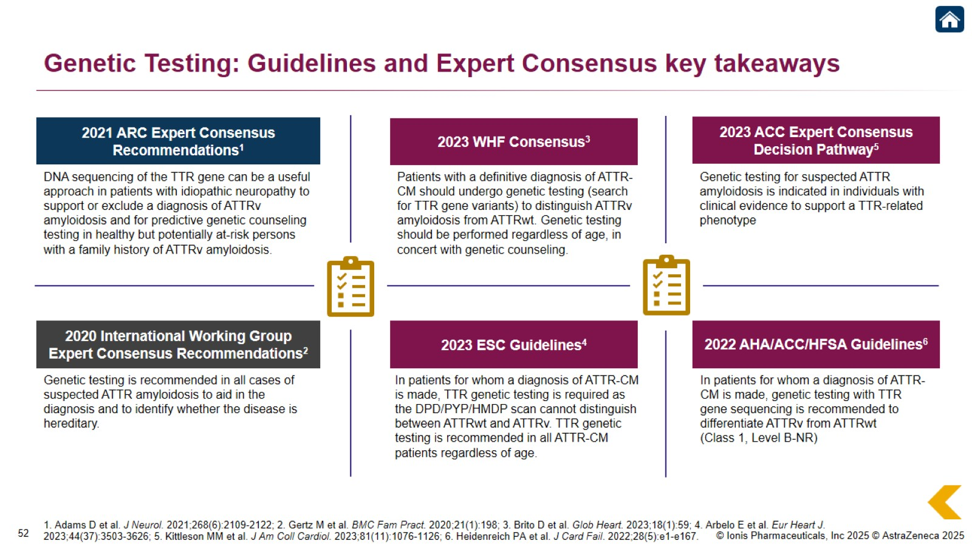
Genetic Testing: Guidelines and Expert Consensus key takeaways

Slide 54
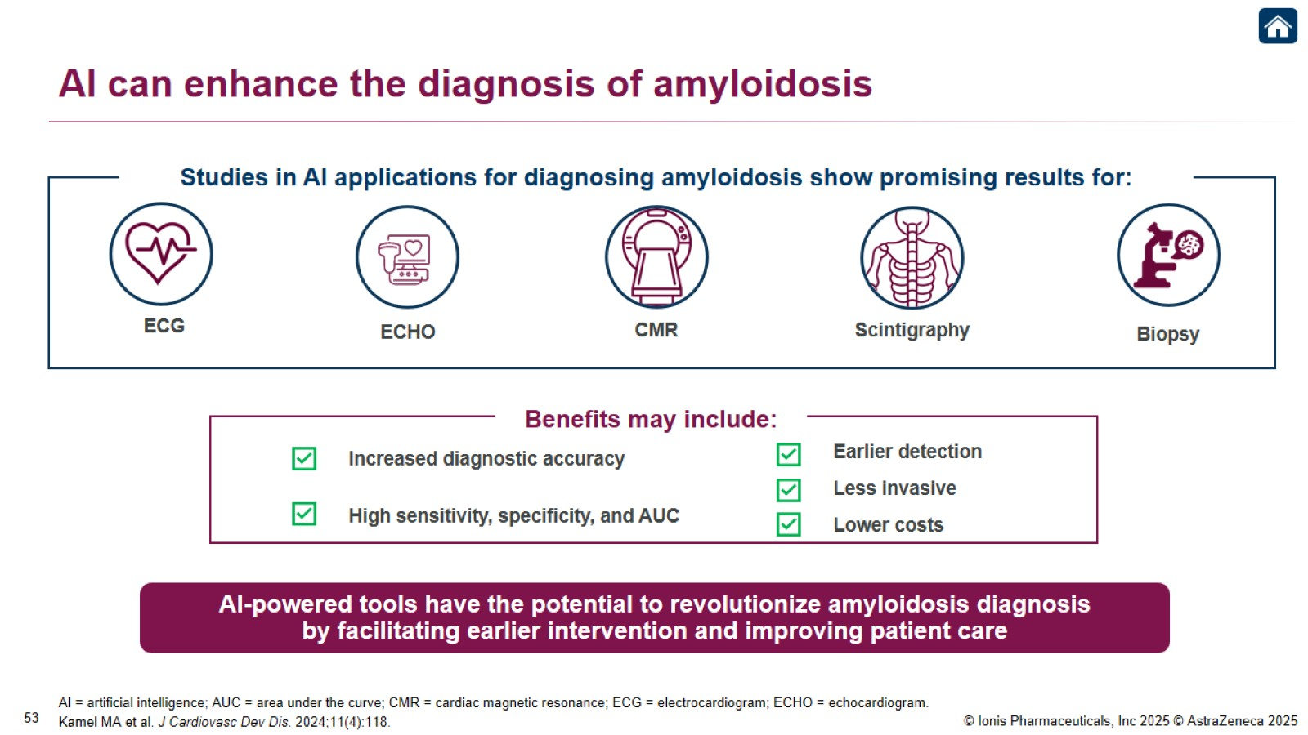
AI can enhance the diagnosis of amyloidosis

Slide 55
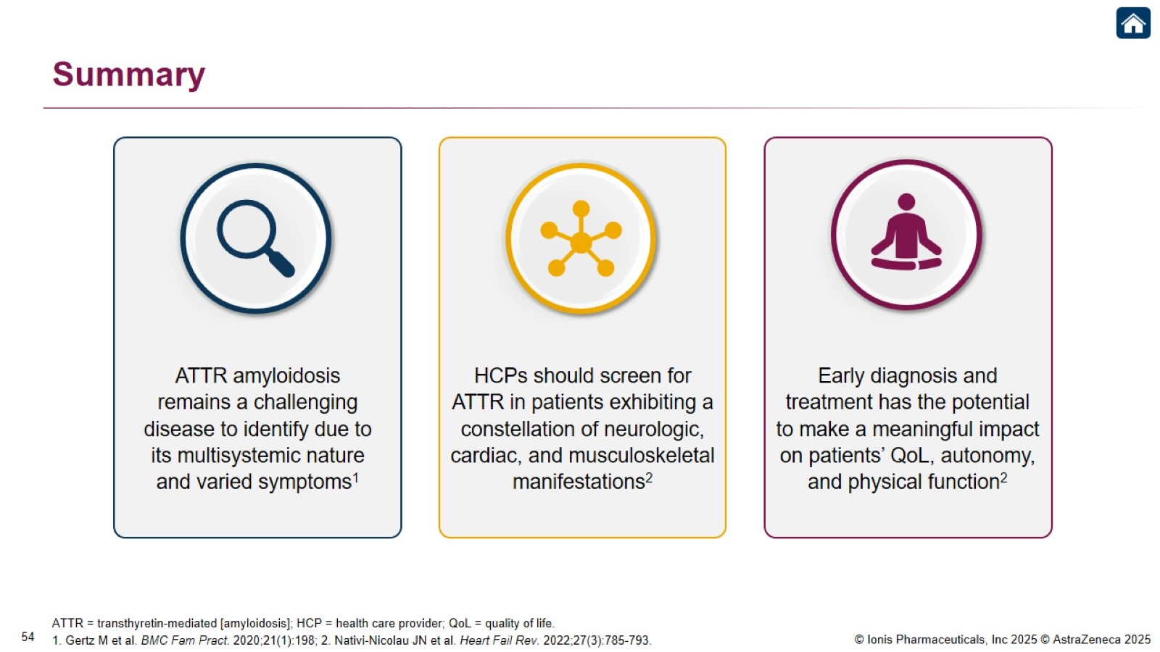
Summary

Slide 56

Neurology Diagnostic Pathway

Slide 57
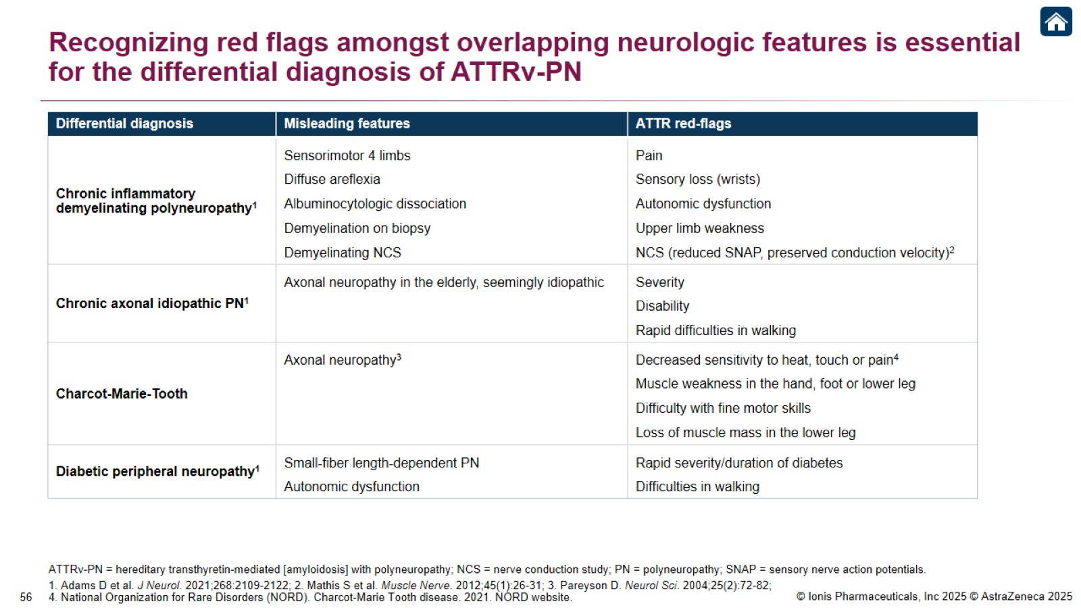
Recognizing red flags amongst overlapping neurologic features is essential for the differential diagnosis of ATTRv-PN

Slide 58
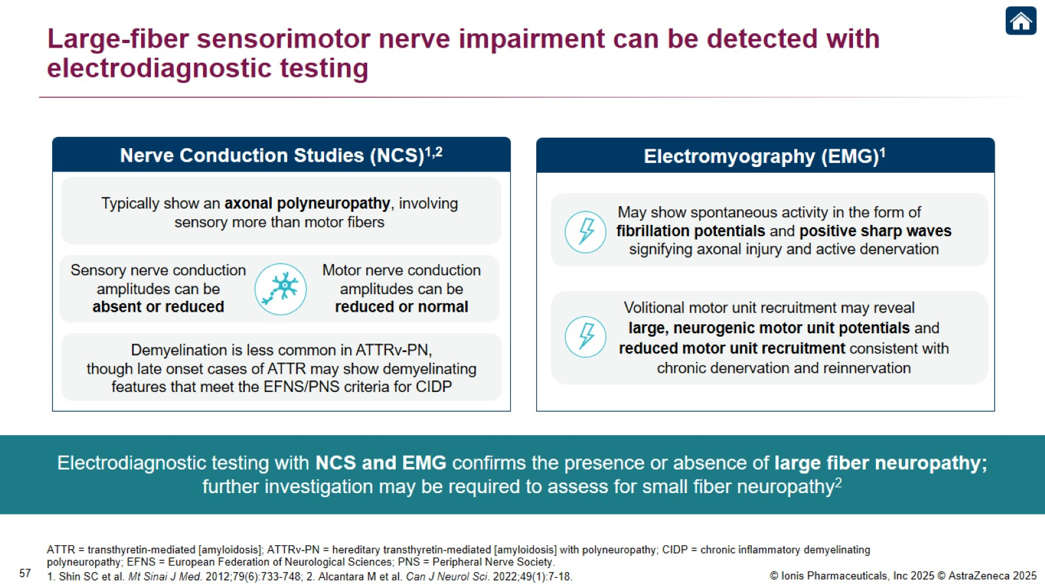
Large-fiber sensorimotor nerve impairment can be detected with electrodiagnostic testing

Slide 59

Evaluation of small-fiber nerve involvement may complement the diagnostic workup¹

Slide 60

Appropriate clinical suspicion can hasten diagnosis of ATTRv-PN

Slide 61

Appropriate clinical suspicion can hasten diagnosis of ATTRv-PN

Slide 62

Genetic testing and amyloid typing allow for diagnosis of ATTRv-PN

Slide 63

Cardiology Diagnostic Pathway

Slide 64

Recognizing red flags amongst overlapping cardiac features is essential for the differential diagnosis of ATTR-CM

Slide 65

A monoclonal protein screening should be performed when cardiac amyloidosis is suspected

Slide 66

Cardiac scintigraphy is a cornerstone of noninvasive ATTR-CM diagnosis¹

Slide 67

Tc-99m-PYP scans can provide an accurate diagnosis of ATTR-CM

Slide 68

Diagnostic Algorithm for Cardiac Amyloidosis

Slide 69

ATTR Amyloidosis Management Strategies

Slide 70

ATTR is a systemic disease requiring multi-disciplinary monitoring and management¹⁻⁵

Slide 71

Staging systems estimate survival in ATTR-CM¹

Slide 72

Experts provide thresholds and frequency for monitoring disease progression in ATTR-CM

Slide 73

Asymptomatic gene carriers should receive ongoing assessment for disease penetrance

Slide 74

Management of ATTR involves a multidisciplinary coordinated approach to patient care

Slide 75

Summary

Slide 76

ATTR amyloidosis: Key takeaways

Slide 77


